Slide 1


Slide 2
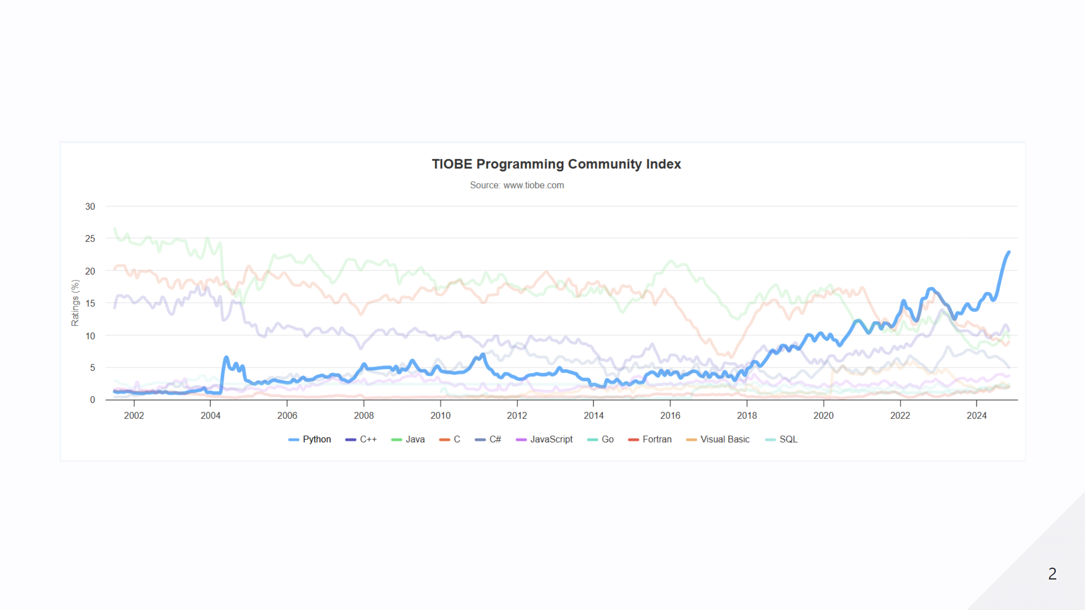

Slide 3
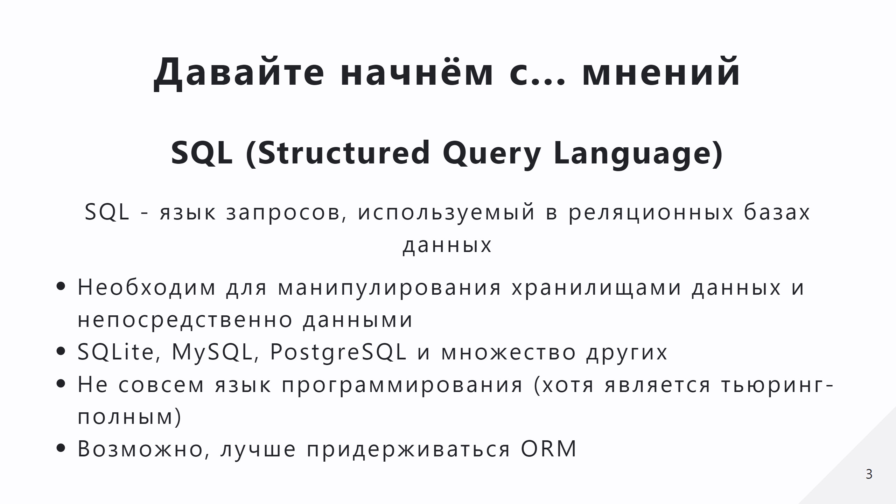

Slide 4
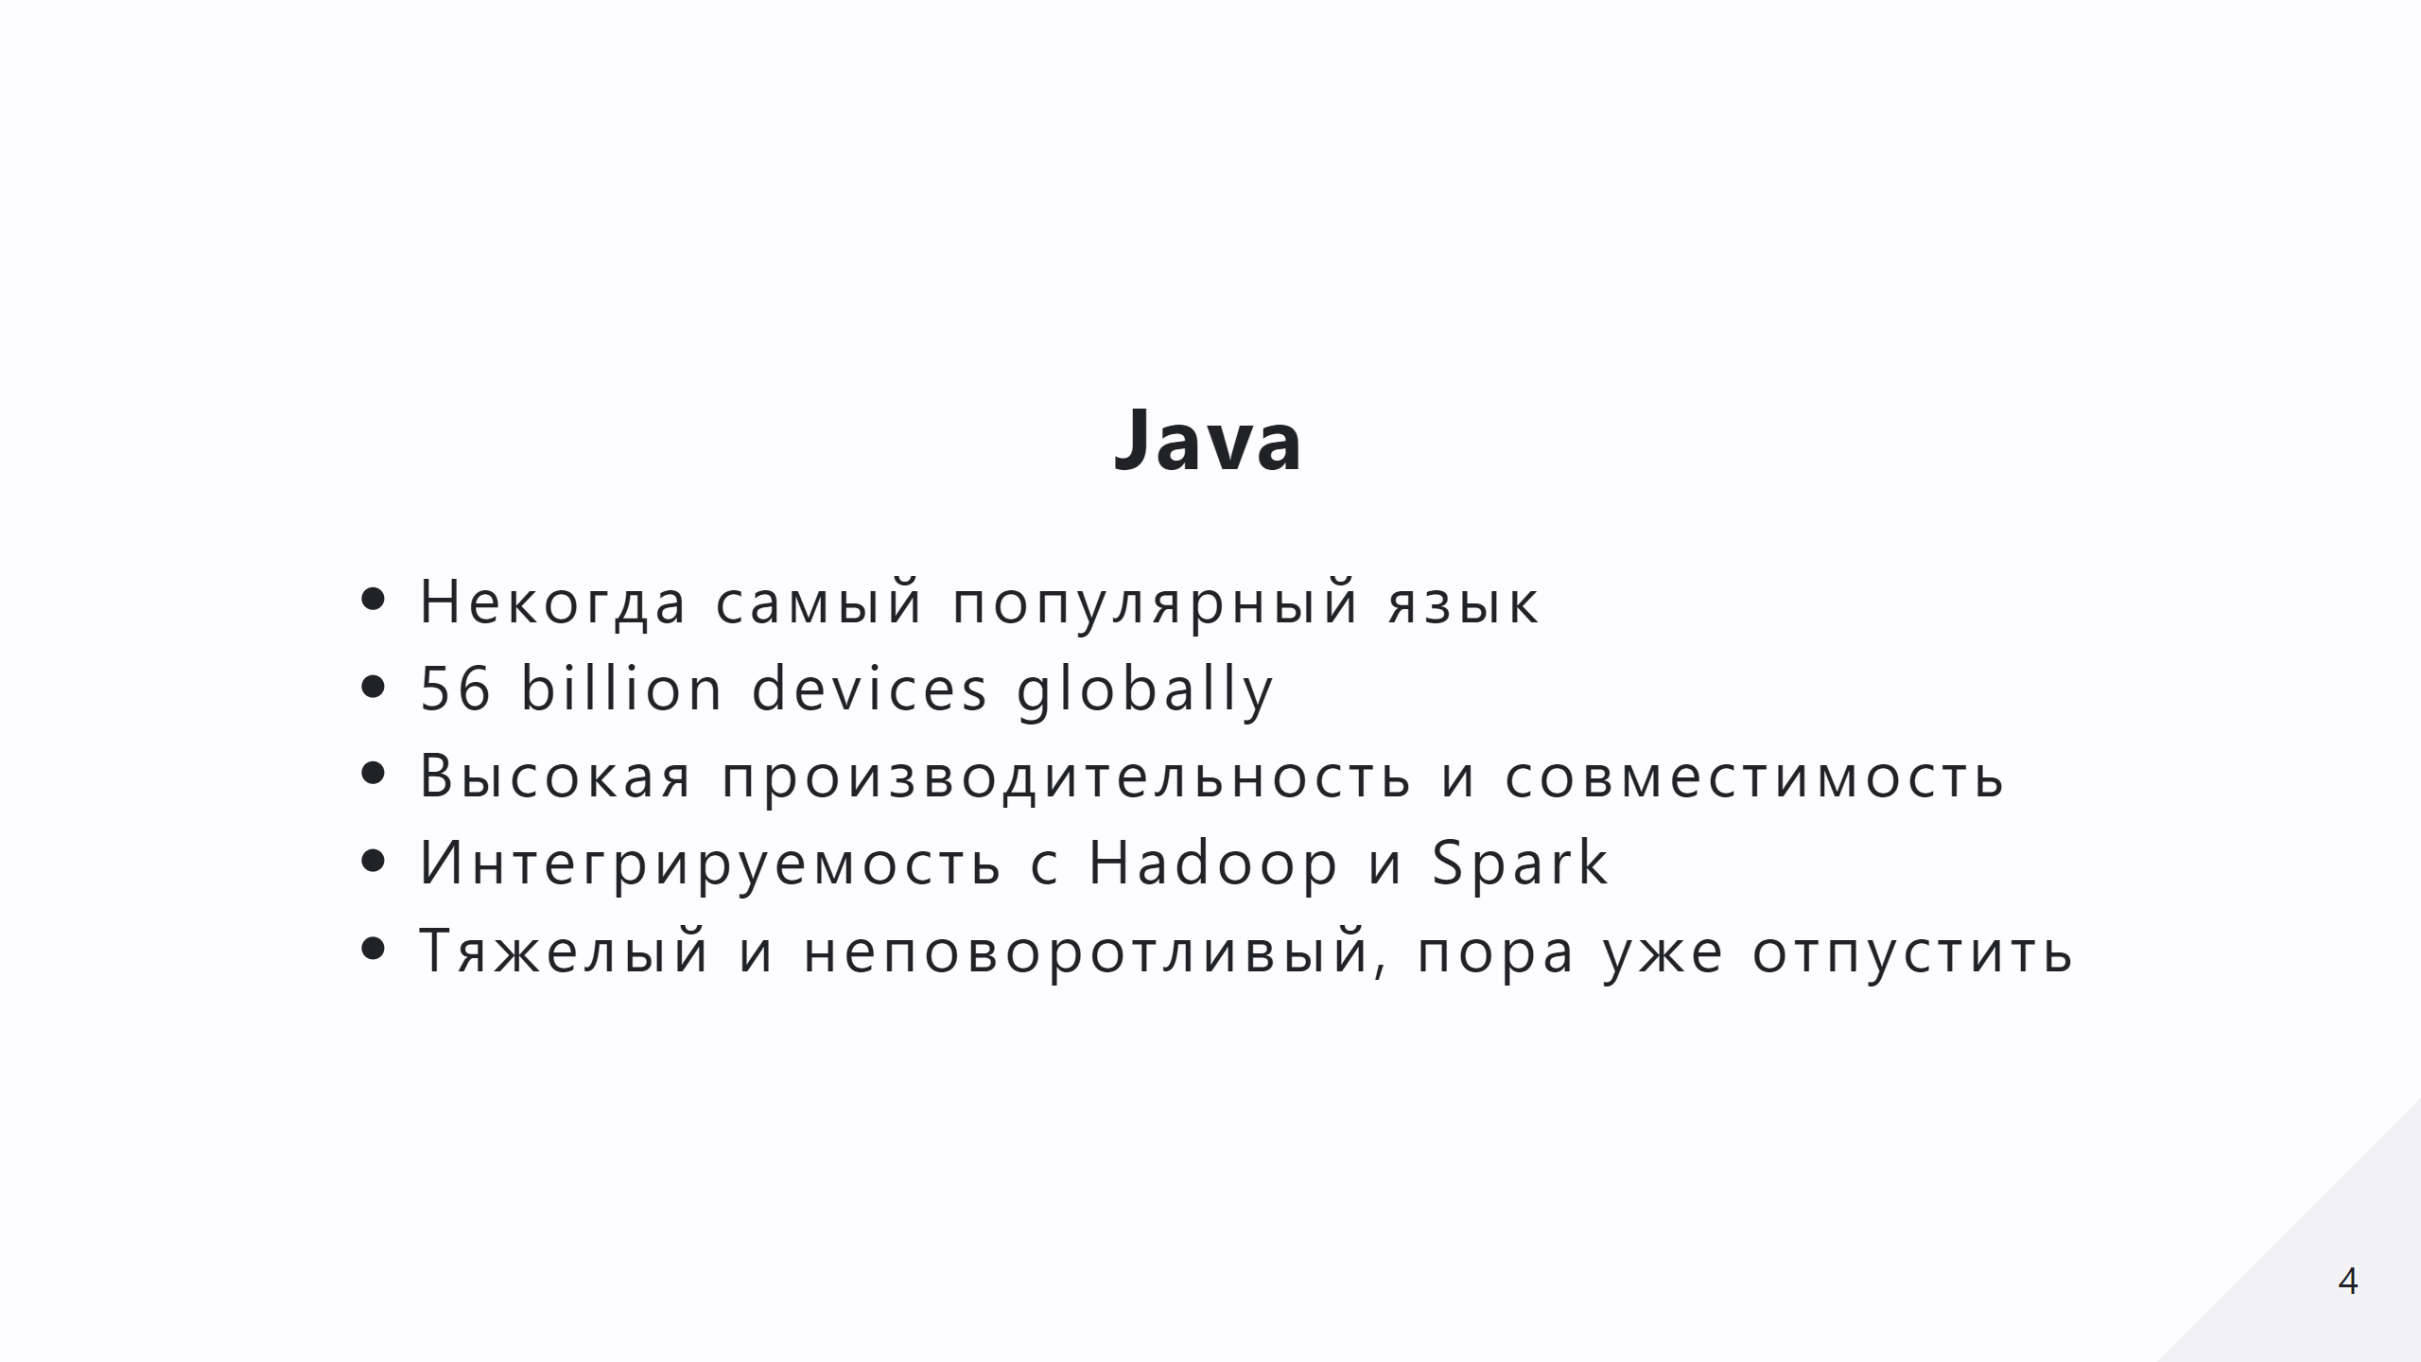

Slide 5
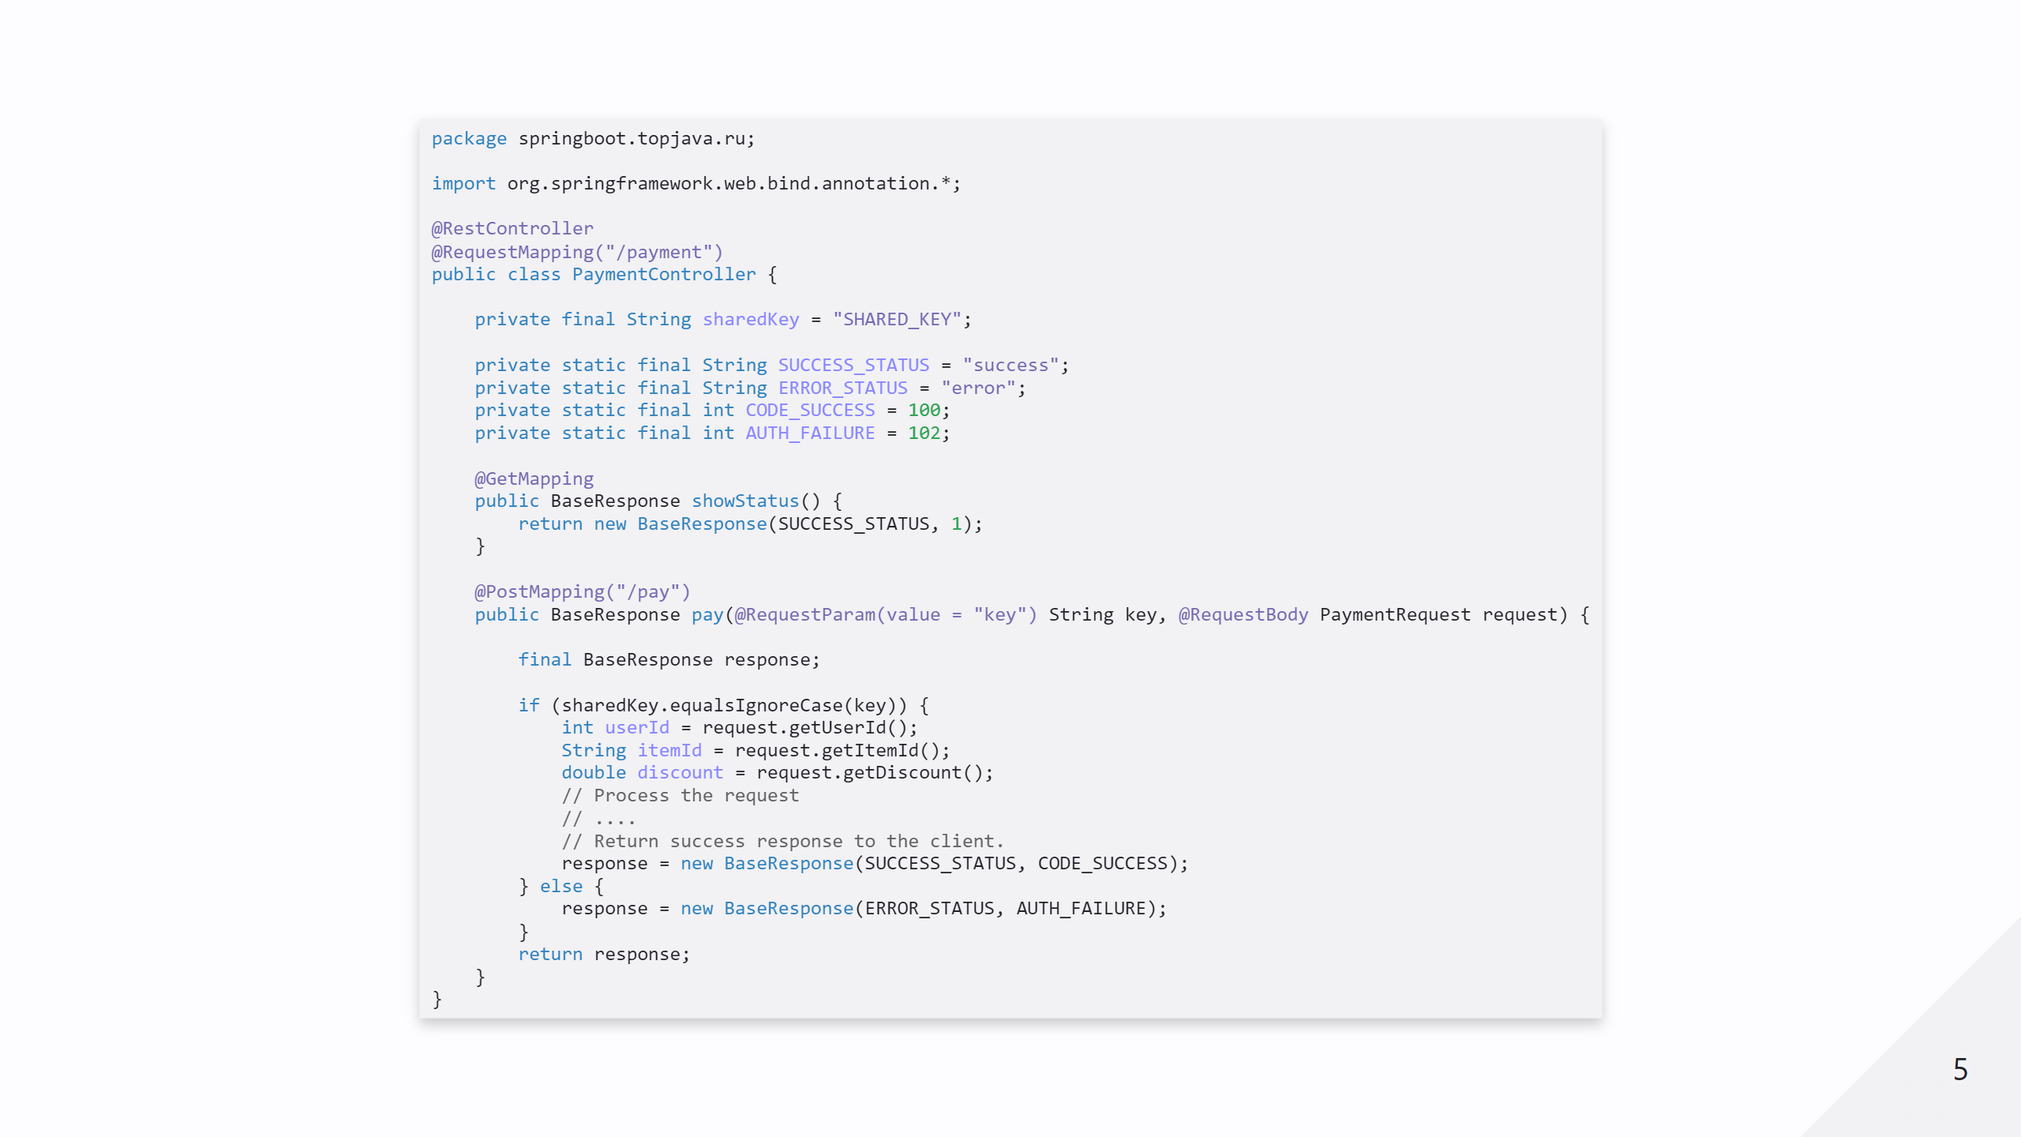

Slide 6
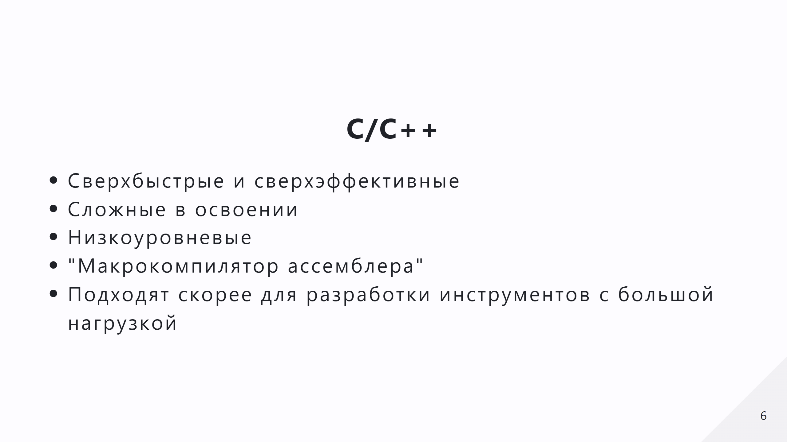

Slide 7
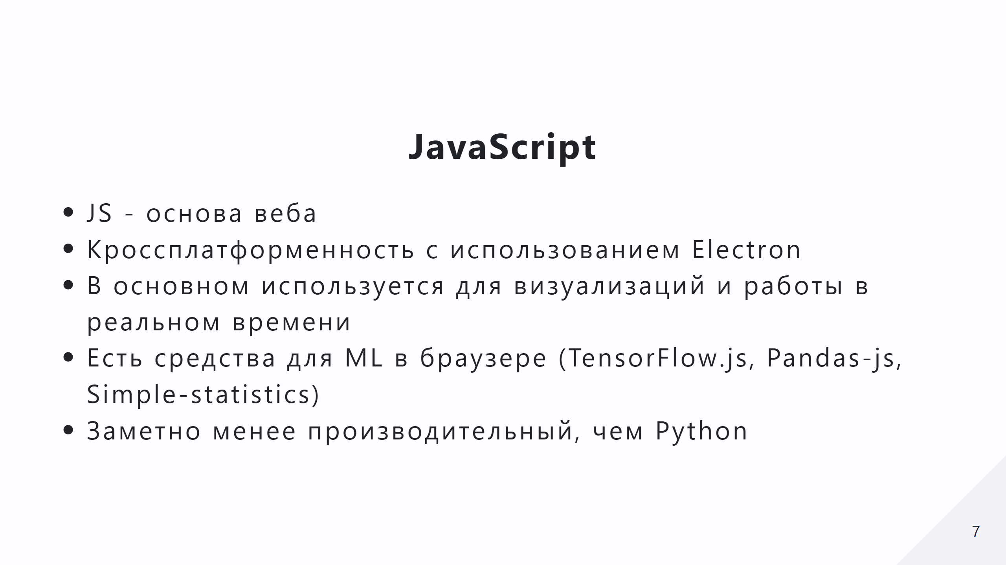

Slide 8
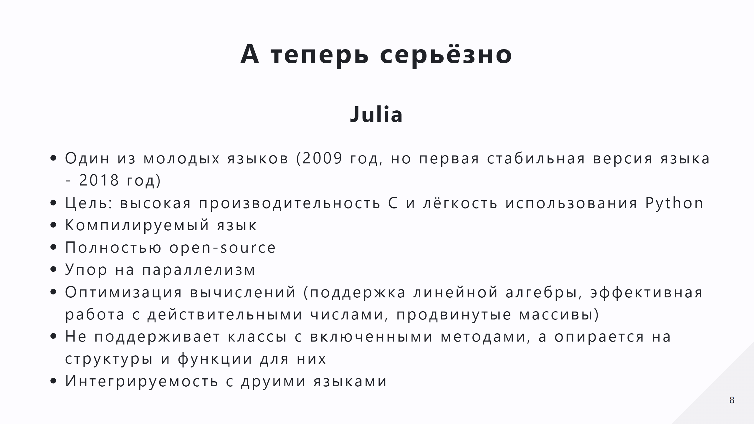

Slide 9
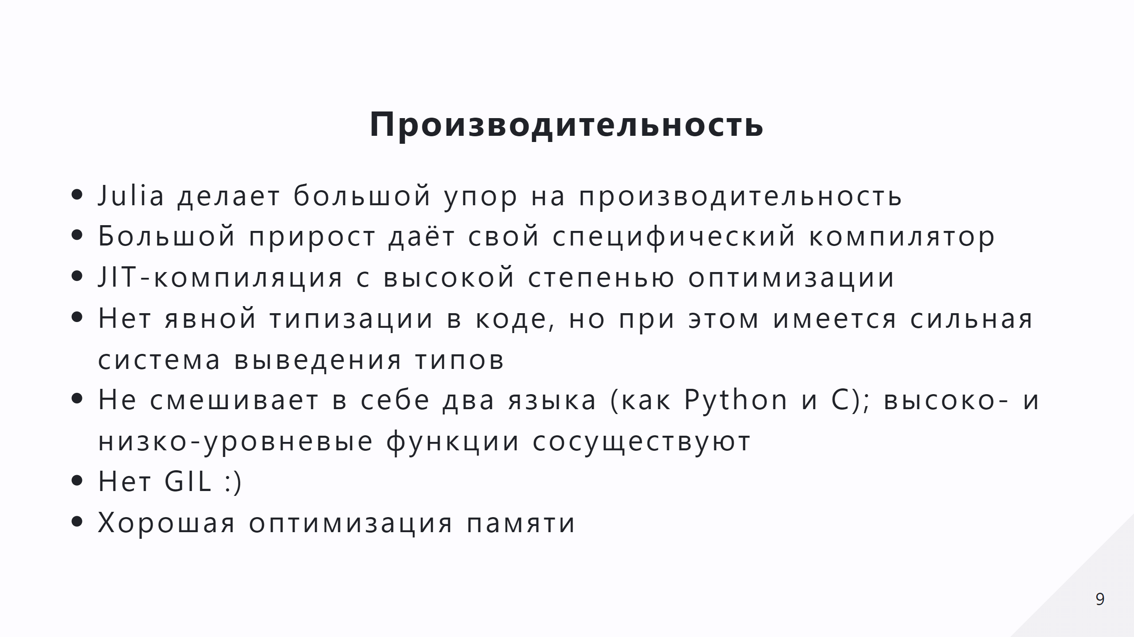

Slide 10
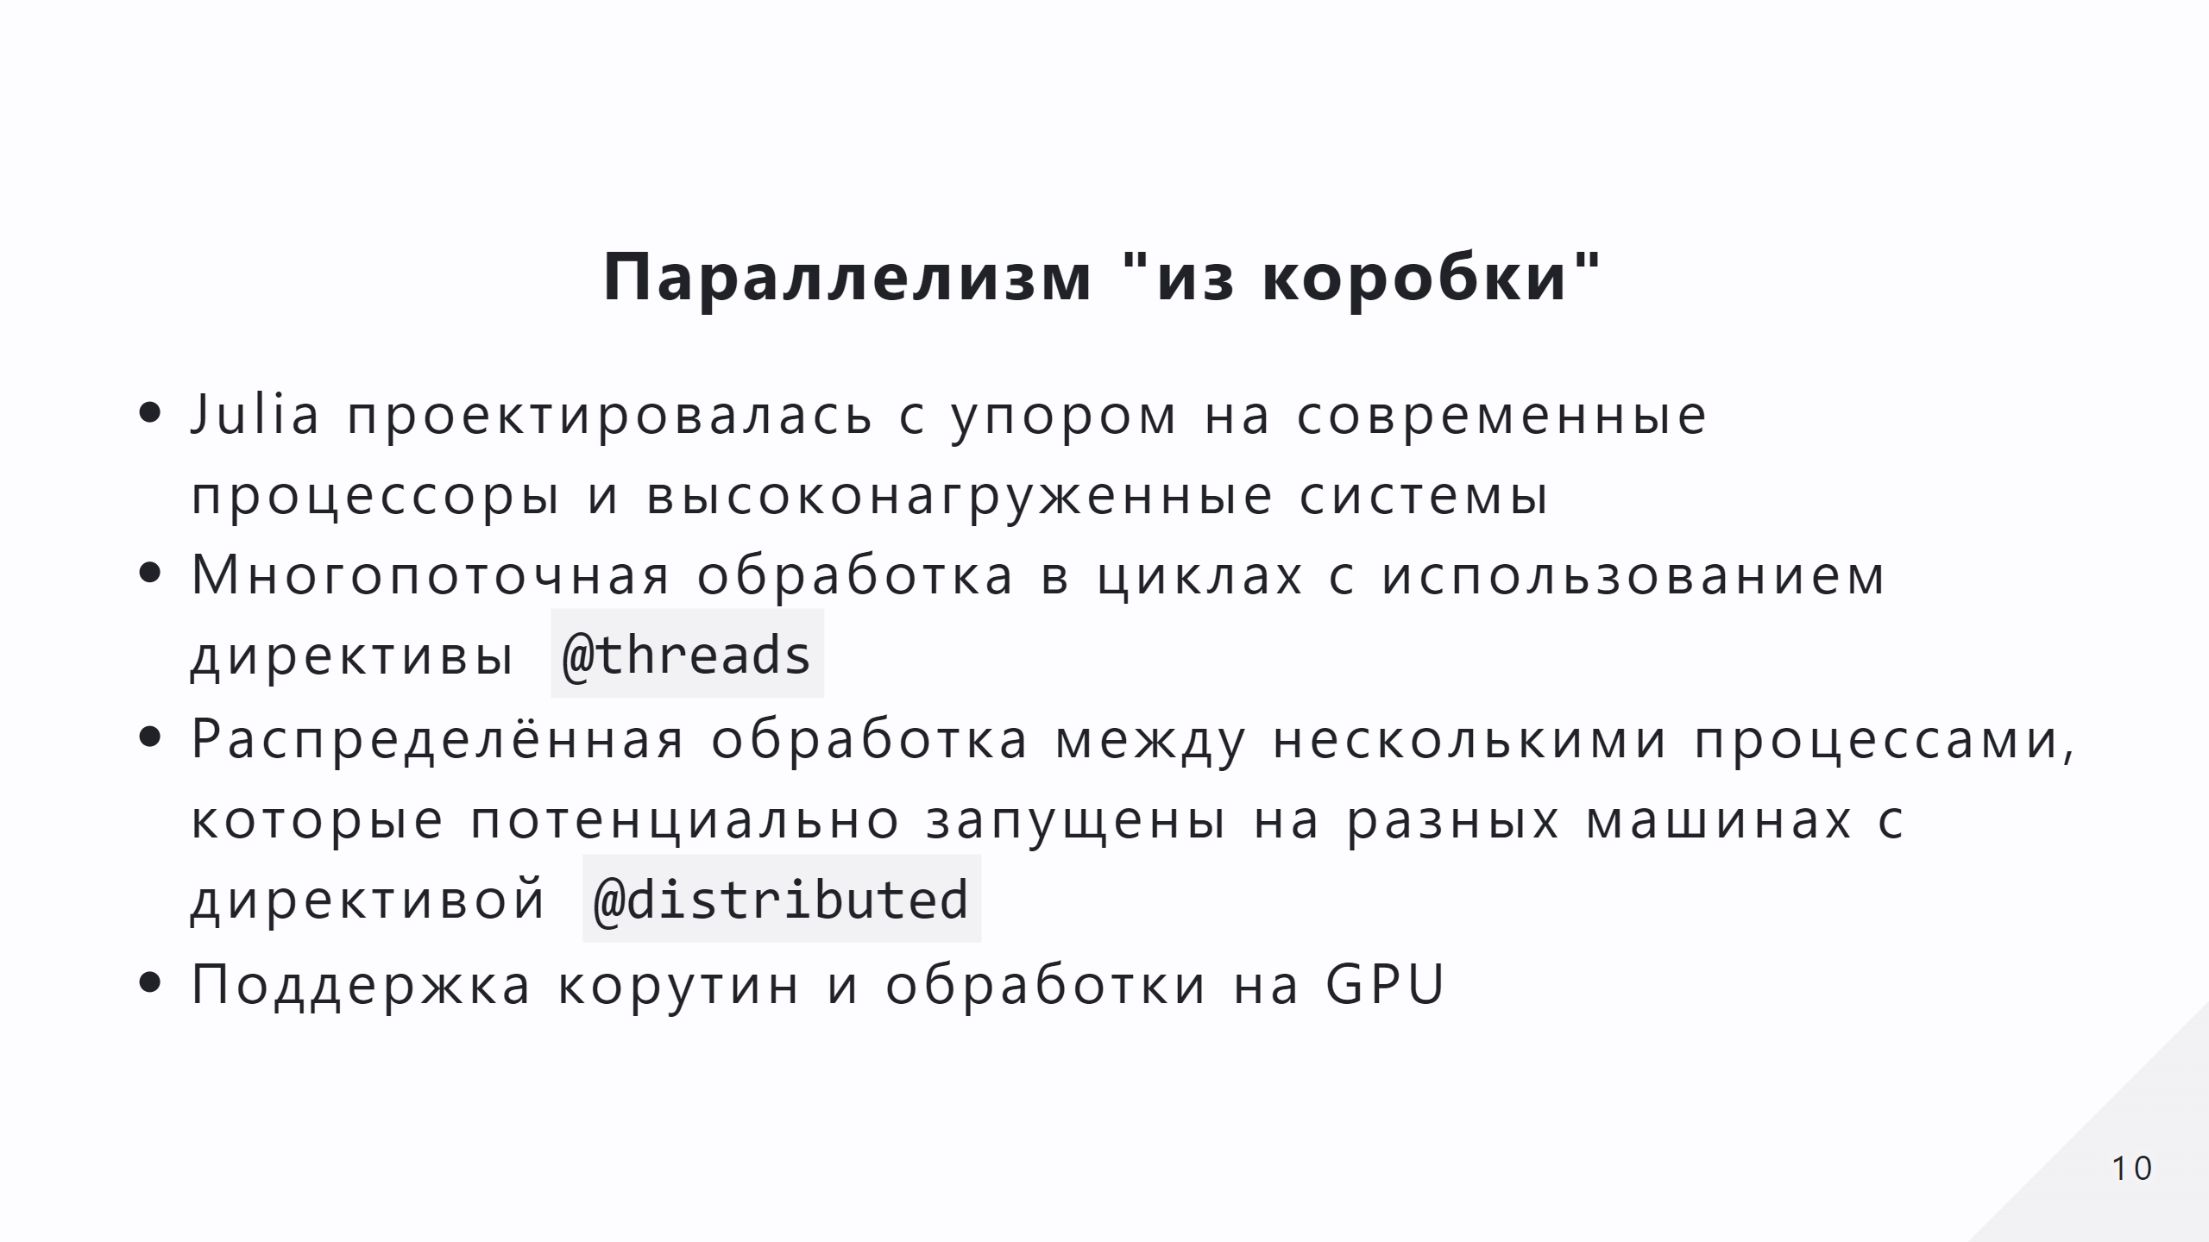

Slide 11
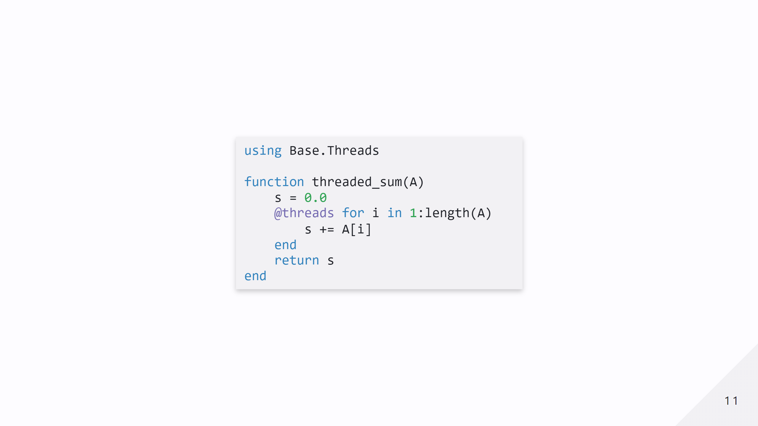

Slide 12
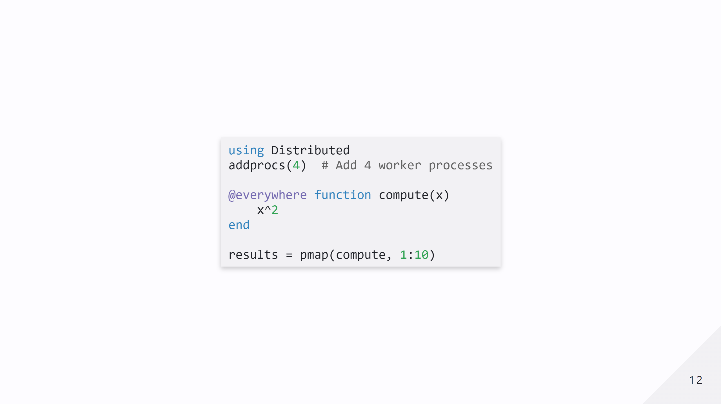
Notes:
- `@everywhere` ensures that the function `compute` is available on all worker processes. - `pmap` distributes tasks intelligently across workers.

Slide 13
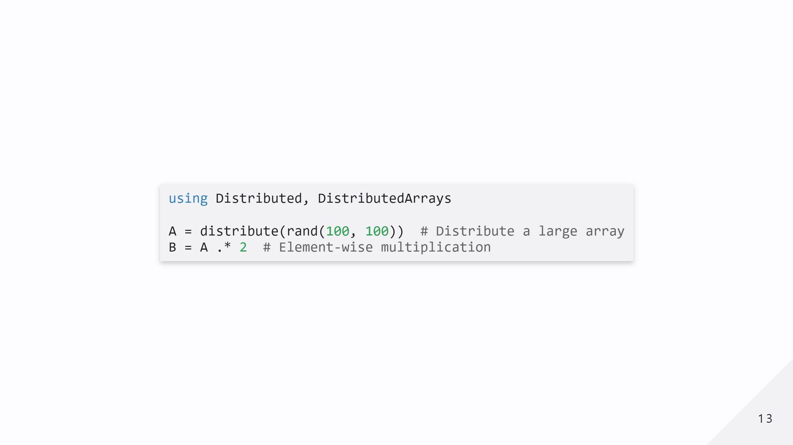
Notes:
Distributed libraries like **DistributedArrays.jl** and **Dagger.jl** make it easier to handle parallel computation on large datasets.

Slide 14
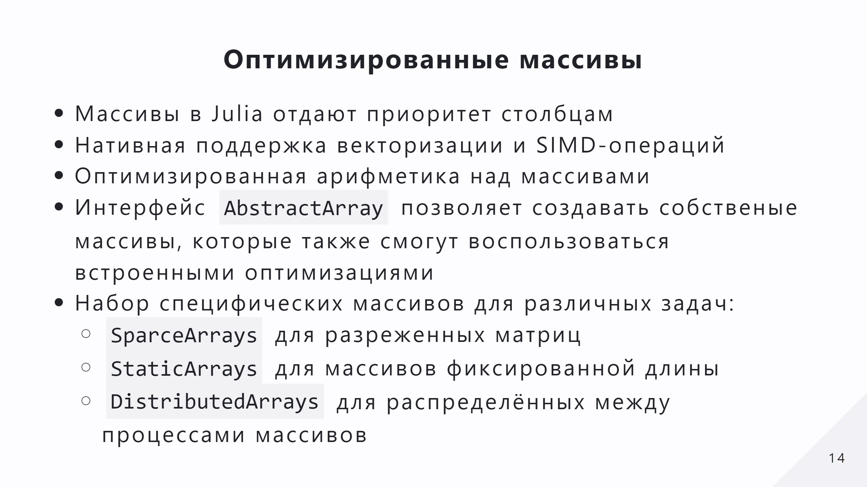
Notes:
- Julia arrays are stored in **column-major order**, like MATLAB and Fortran. This means that elements in the same column of a 2D array are stored contiguously in memory. - Julia leverages **Single Instruction Multiple Data (SIMD)** instructions, which enable processing multiple array elements simultaneously on modern CPUs. - Many array operations are automatically **vectorized**, taking full advantage of SIMD without requiring explicit coding by the user.

Slide 15
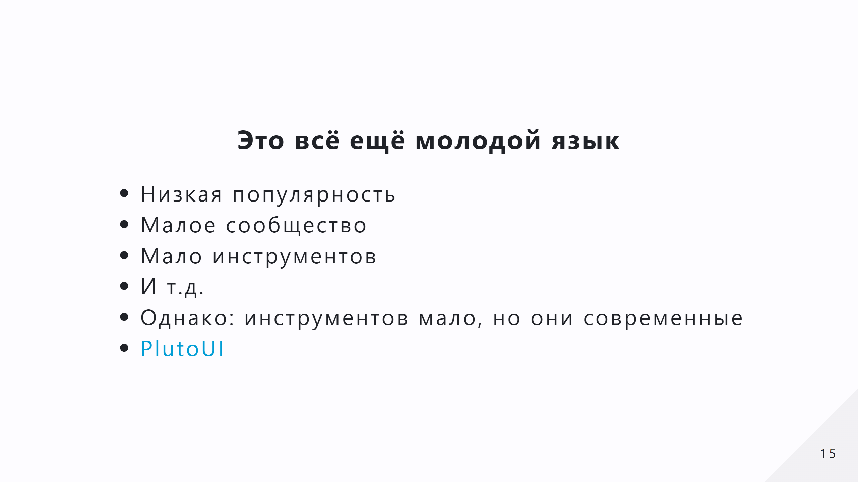

Slide 16
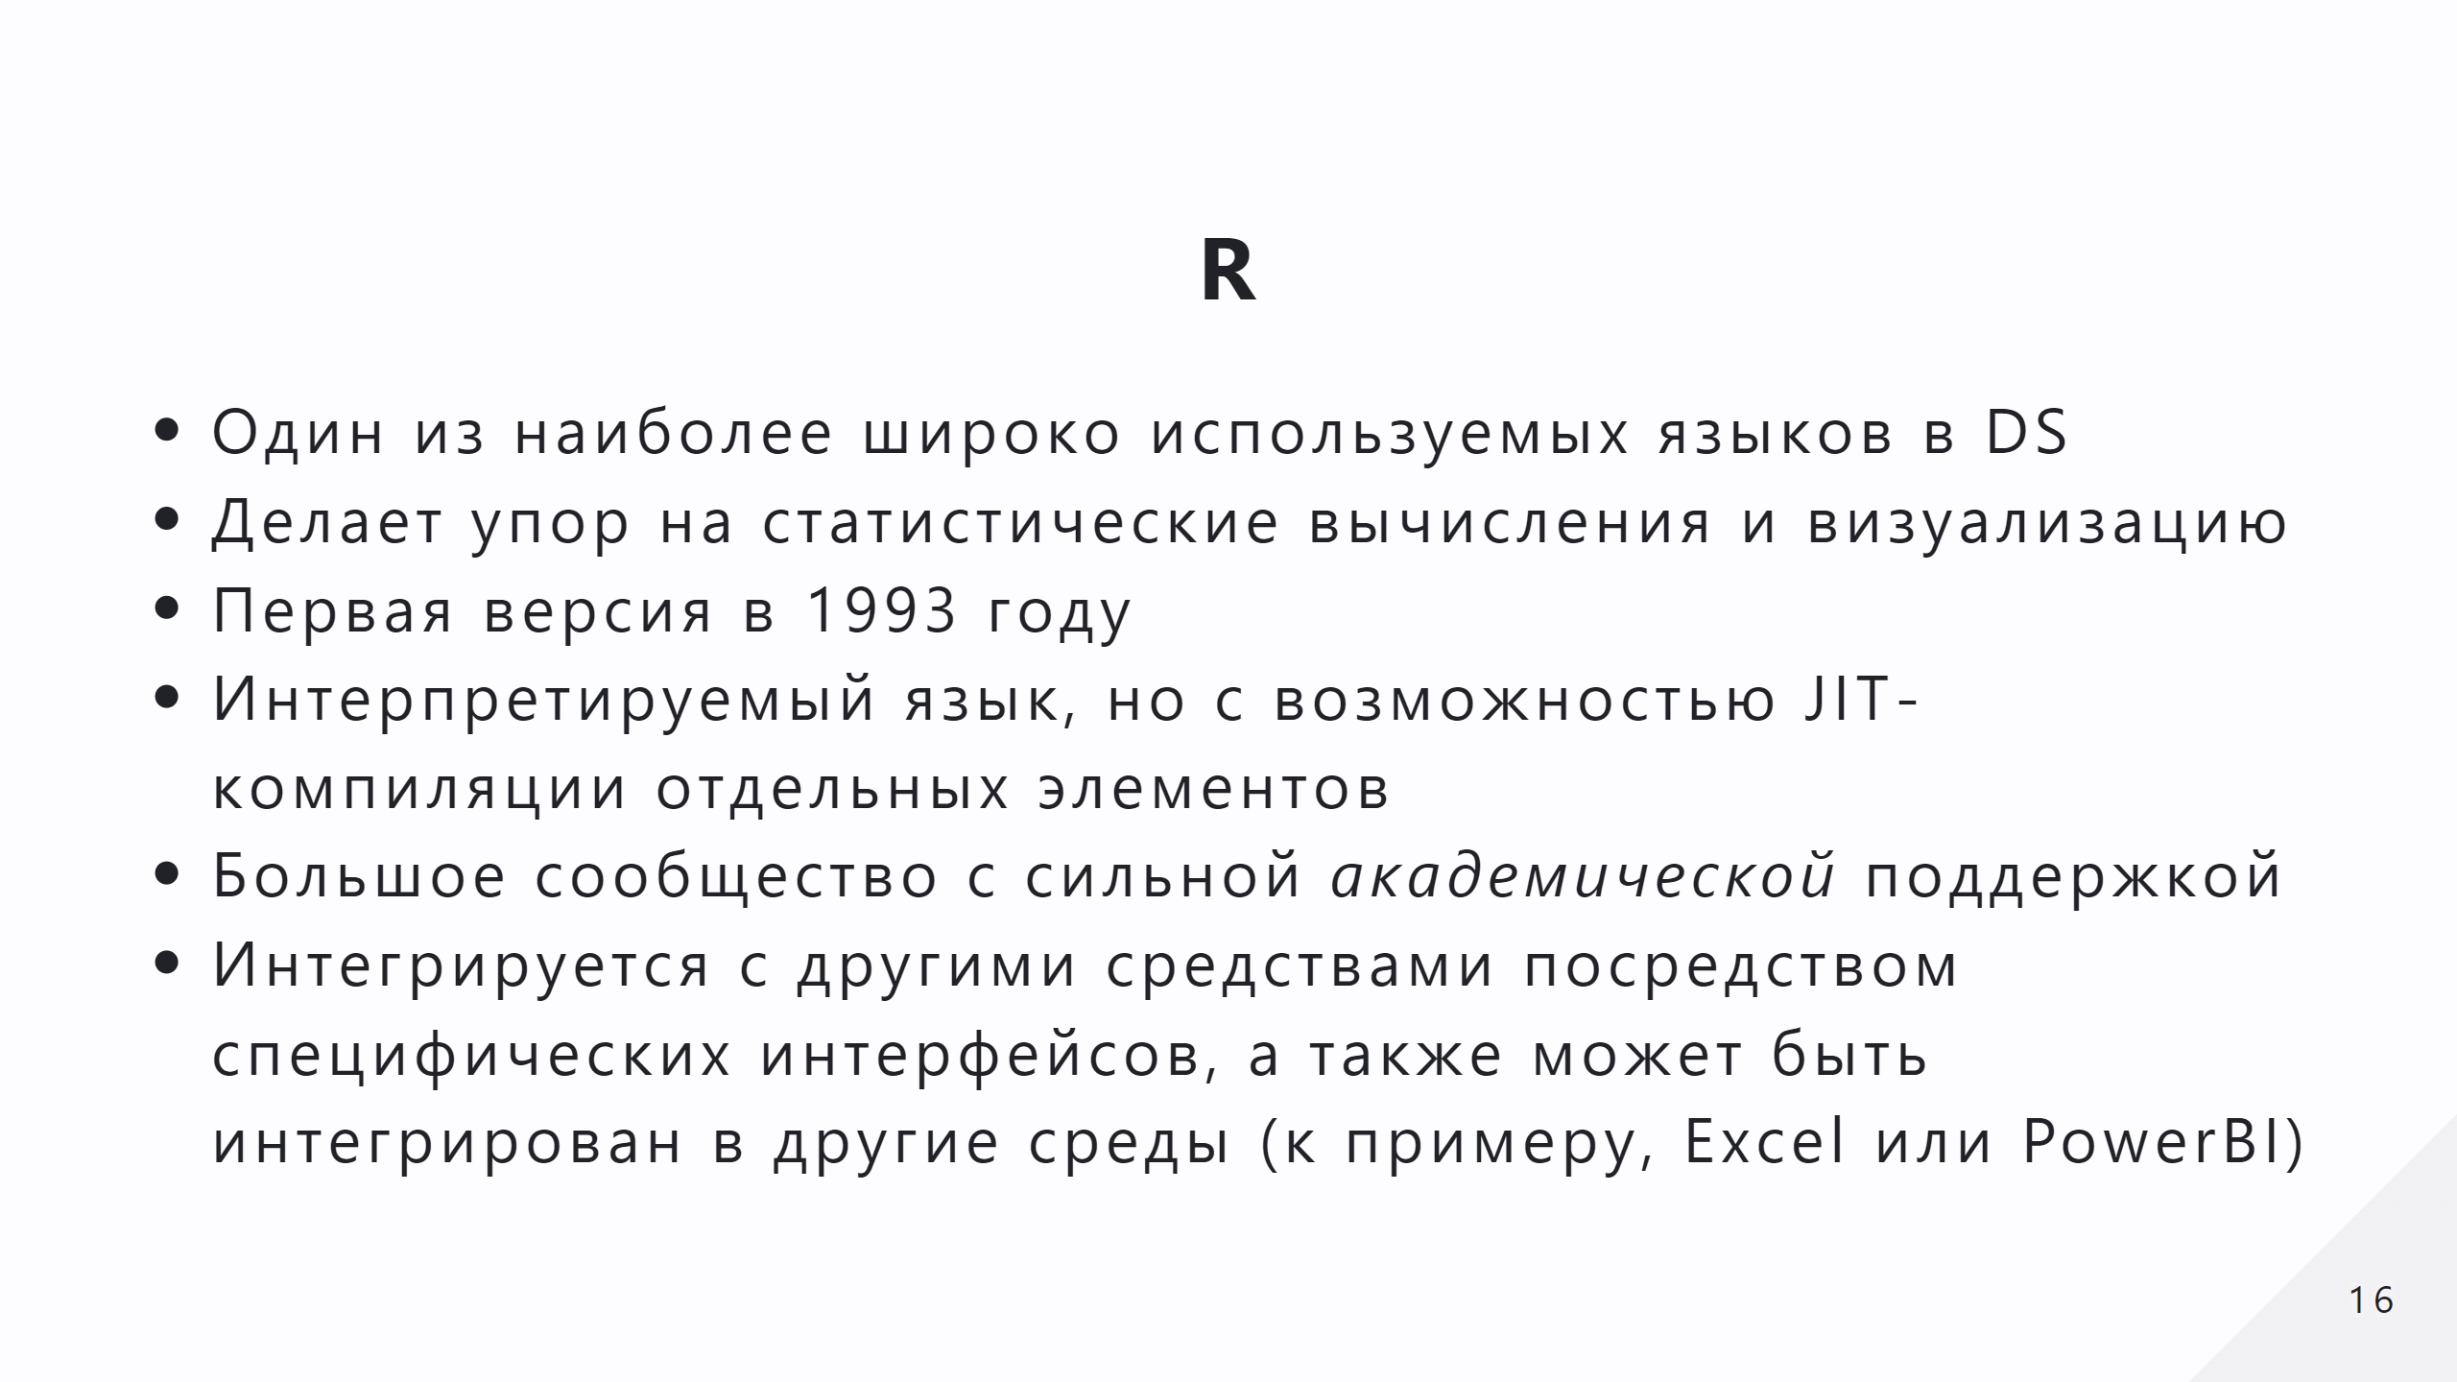

Slide 17
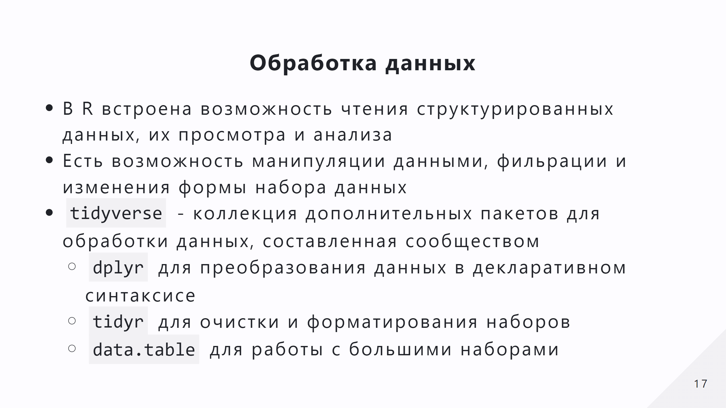

Slide 18
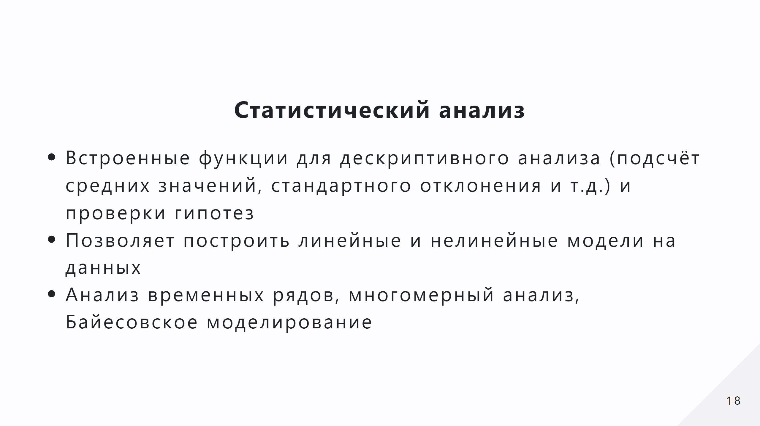

Slide 19
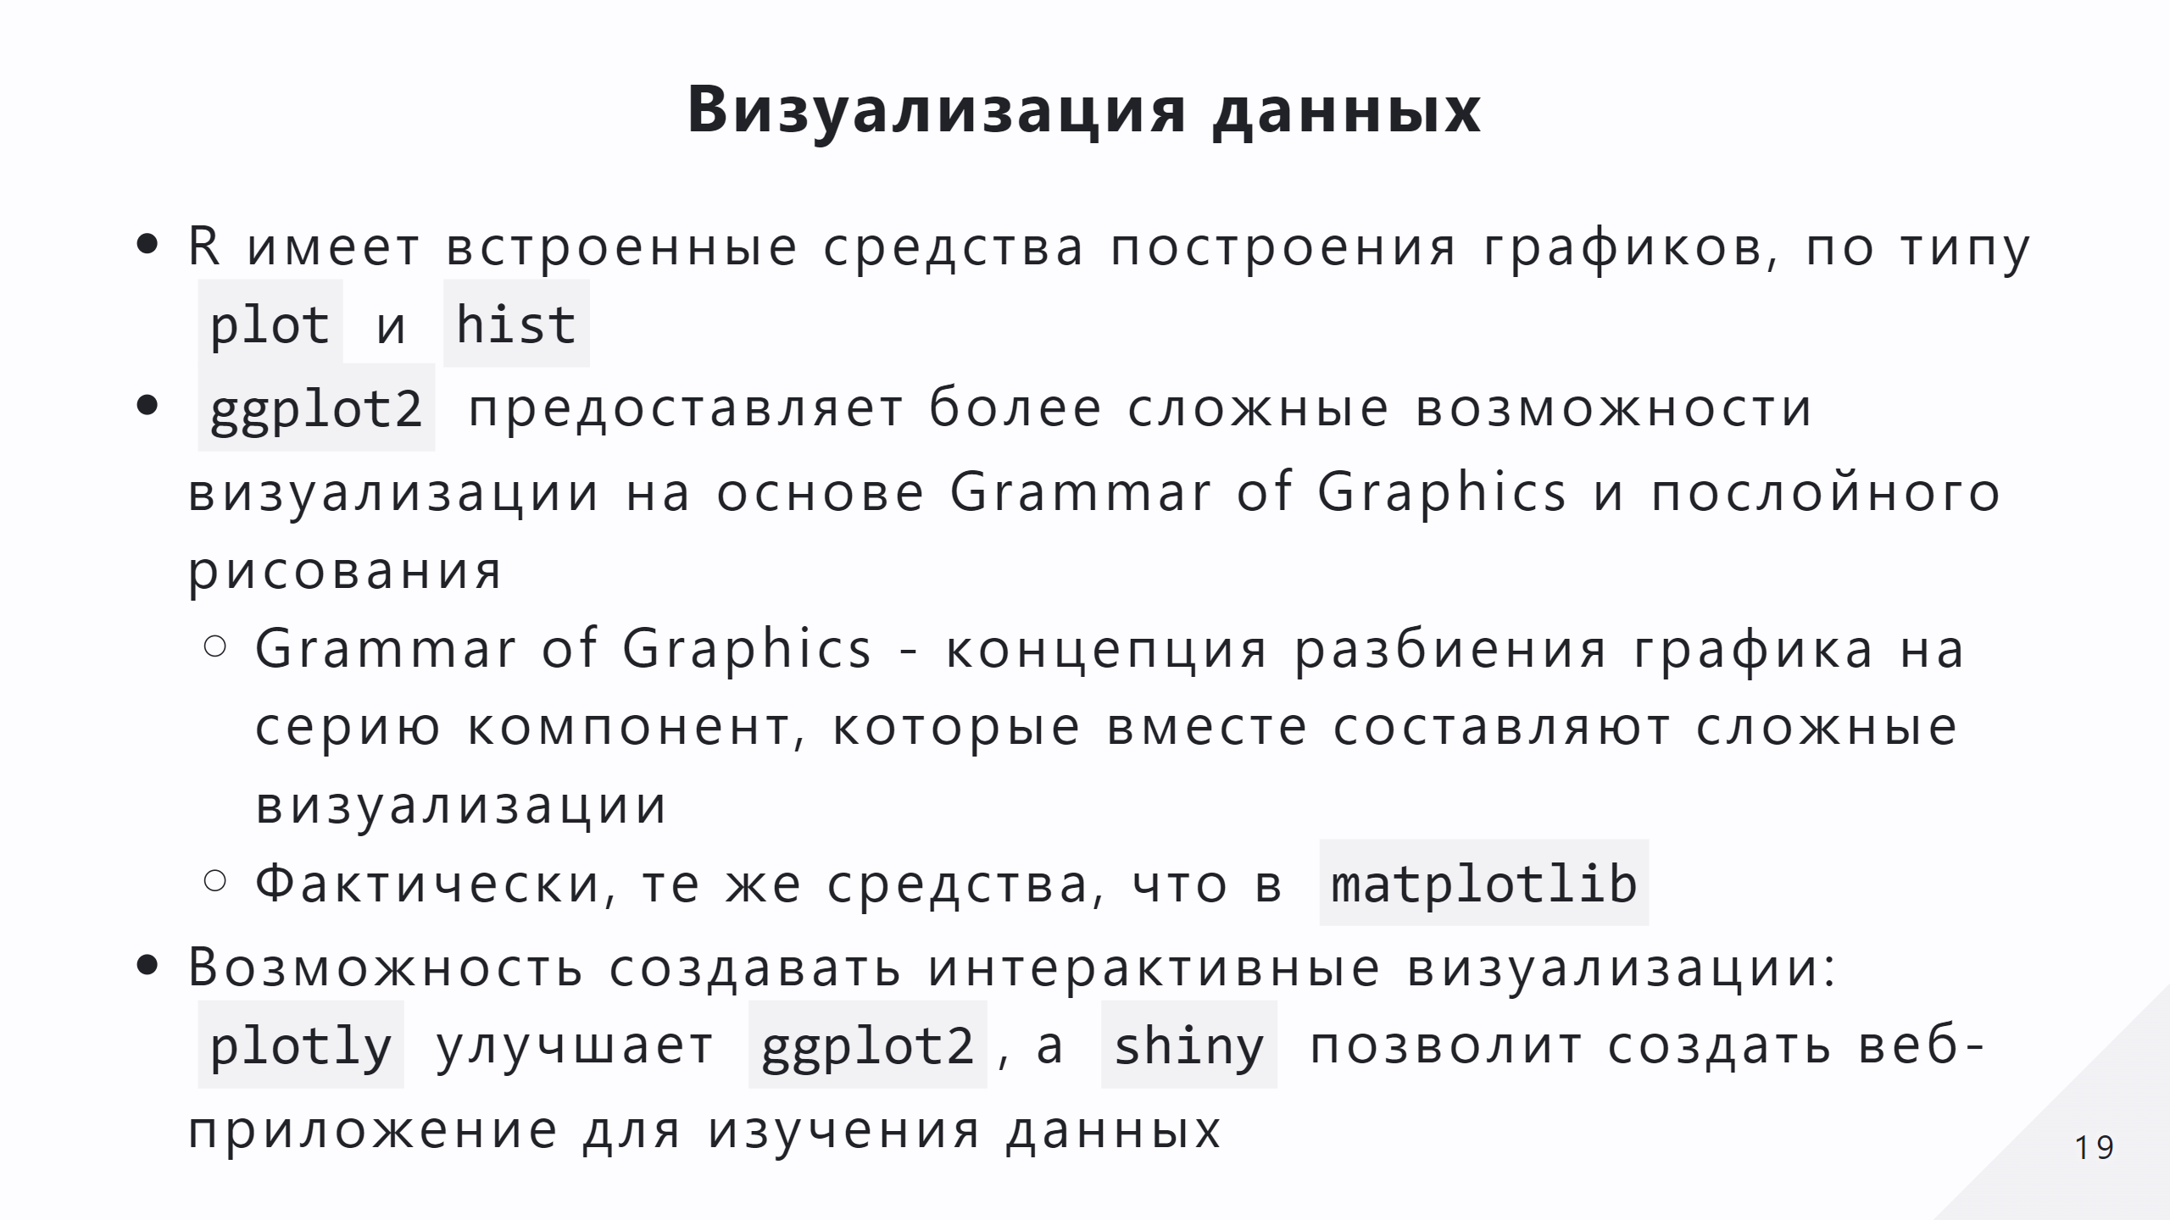

Slide 20
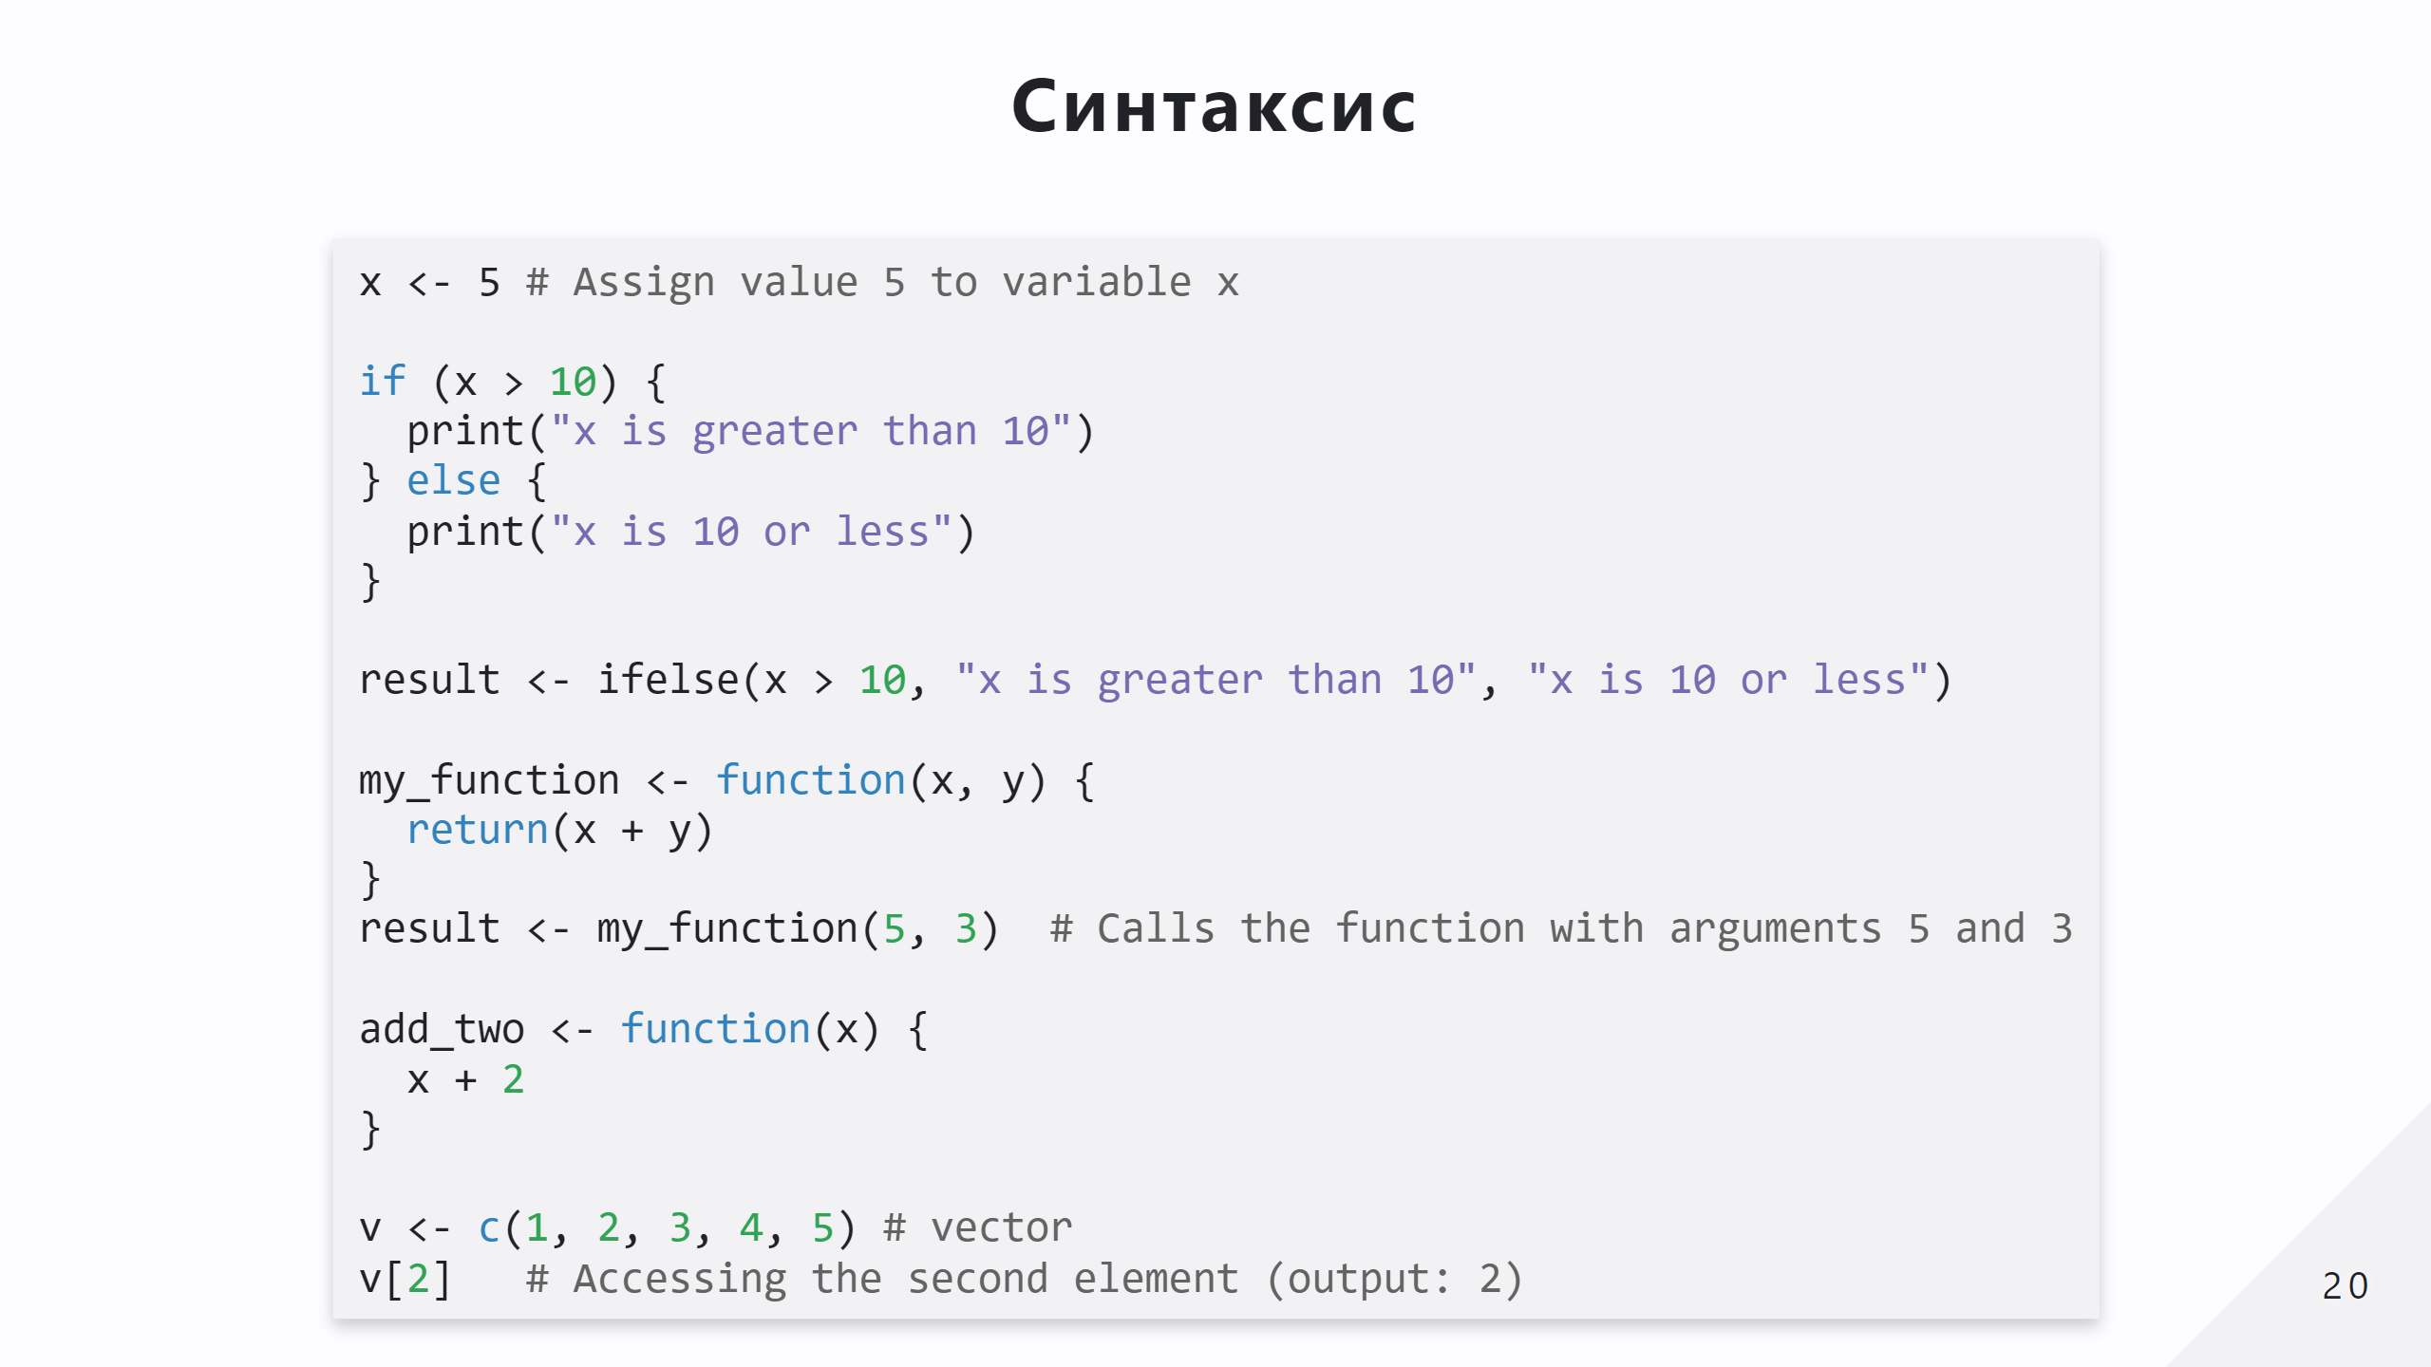

Slide 21
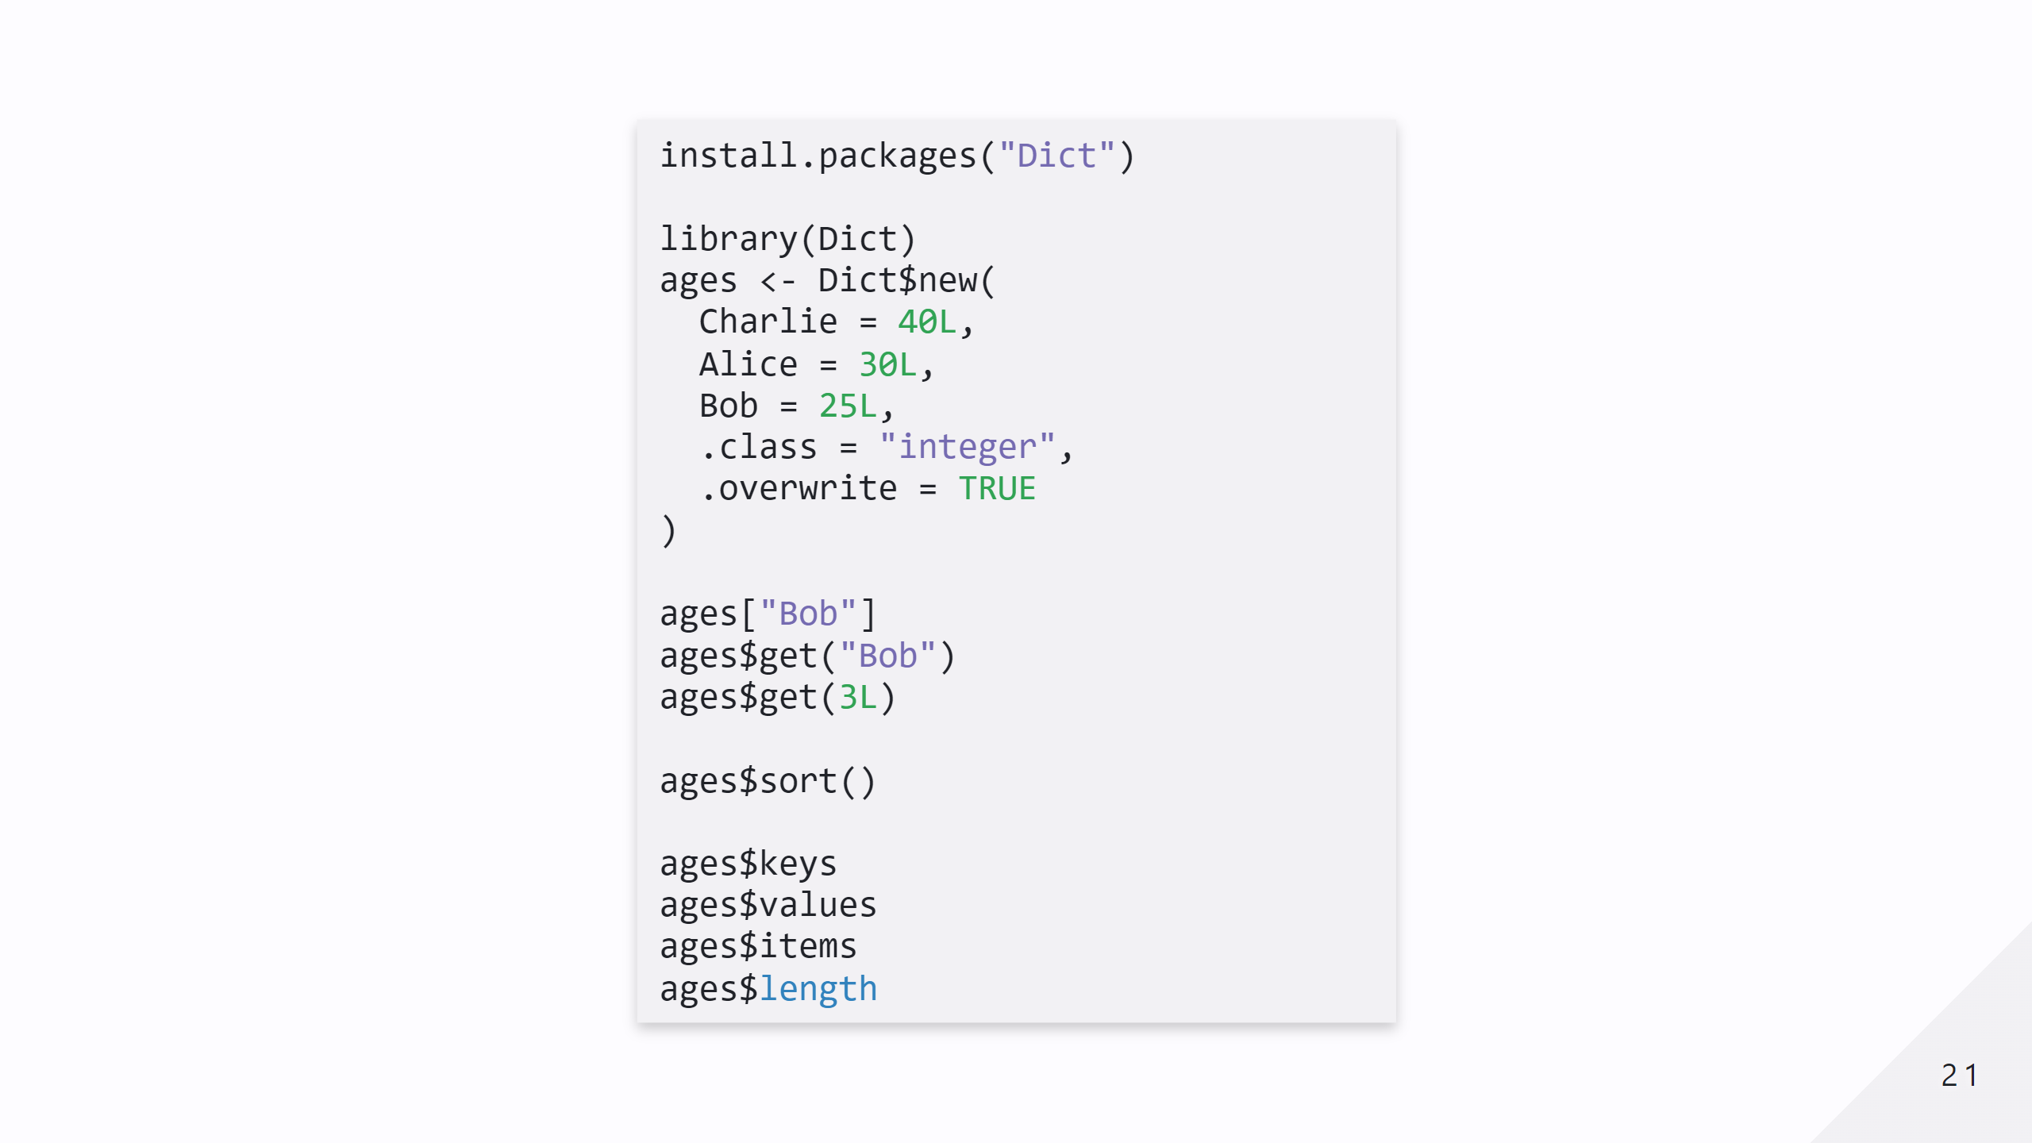

Slide 22
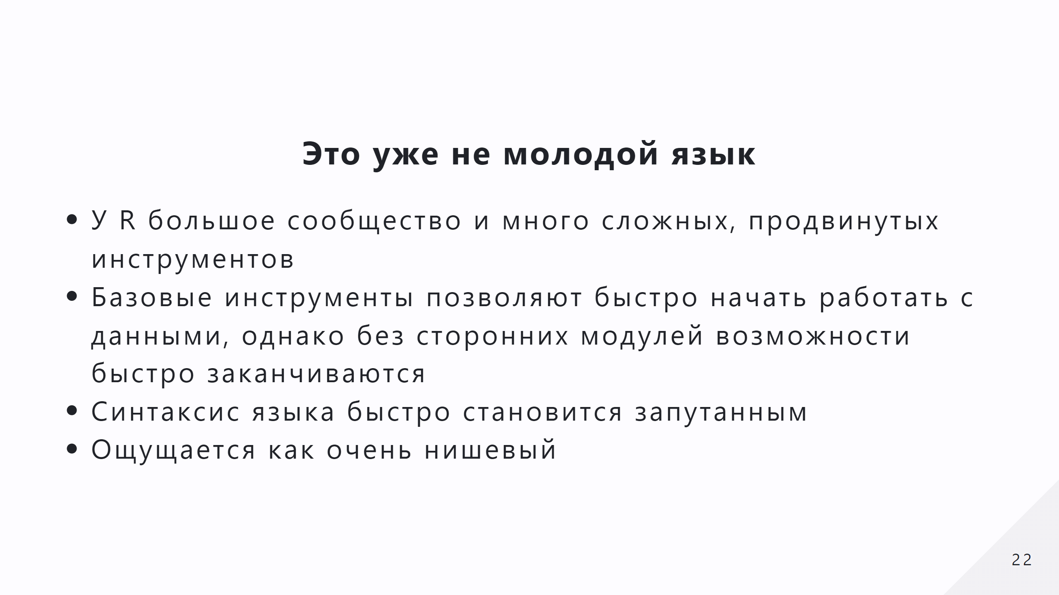

Slide 23
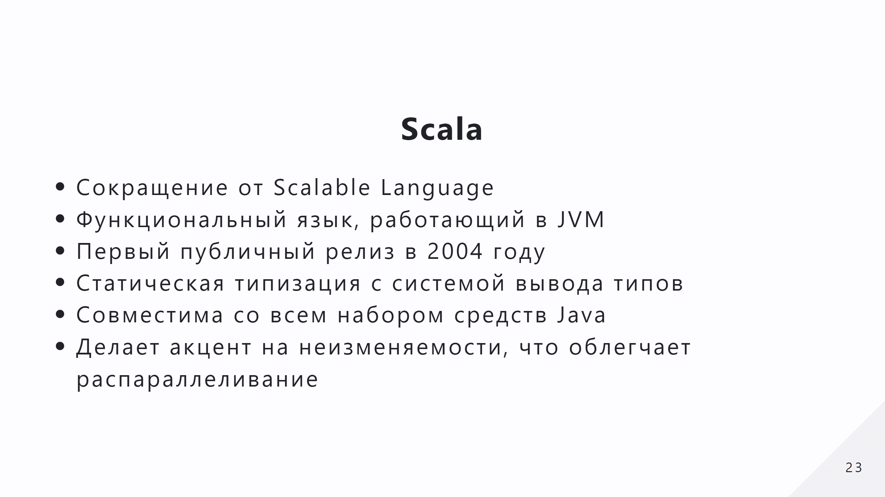

Slide 24
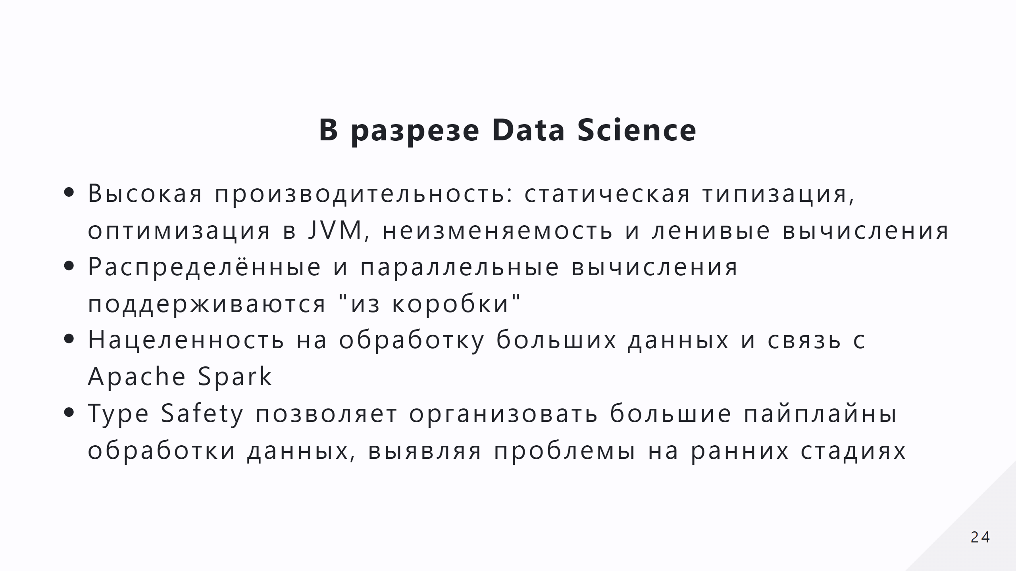

Slide 25
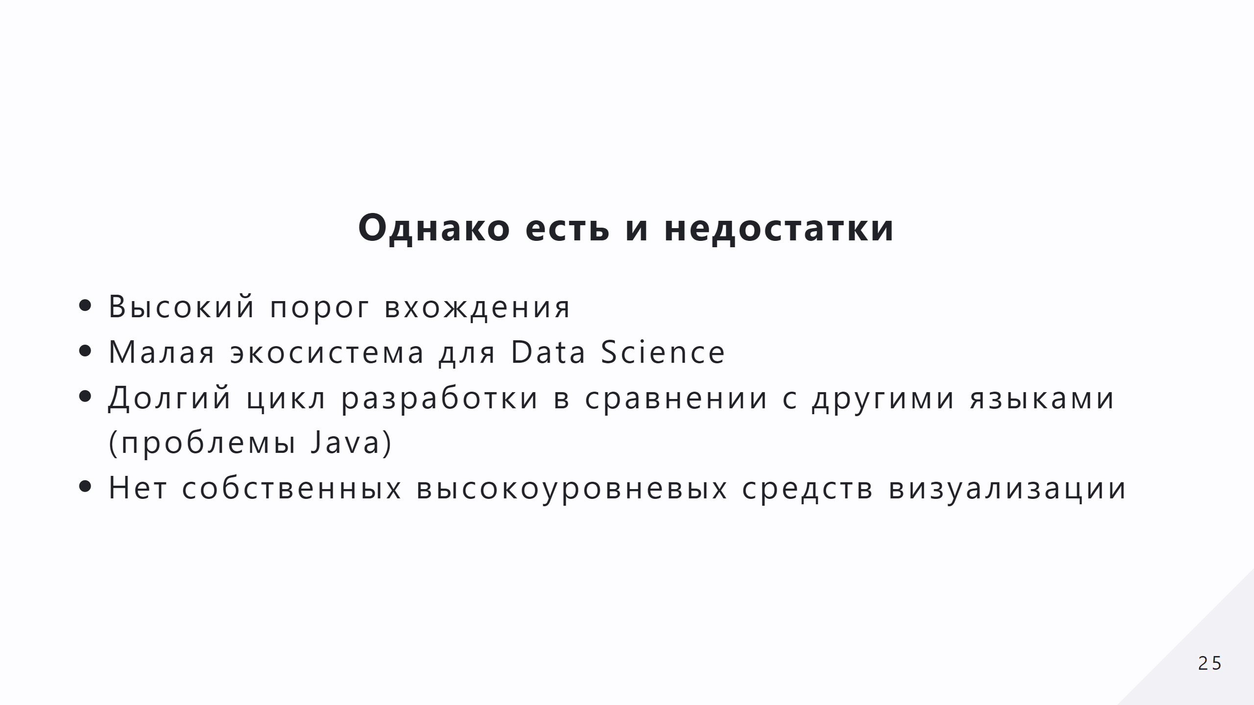

Slide 26
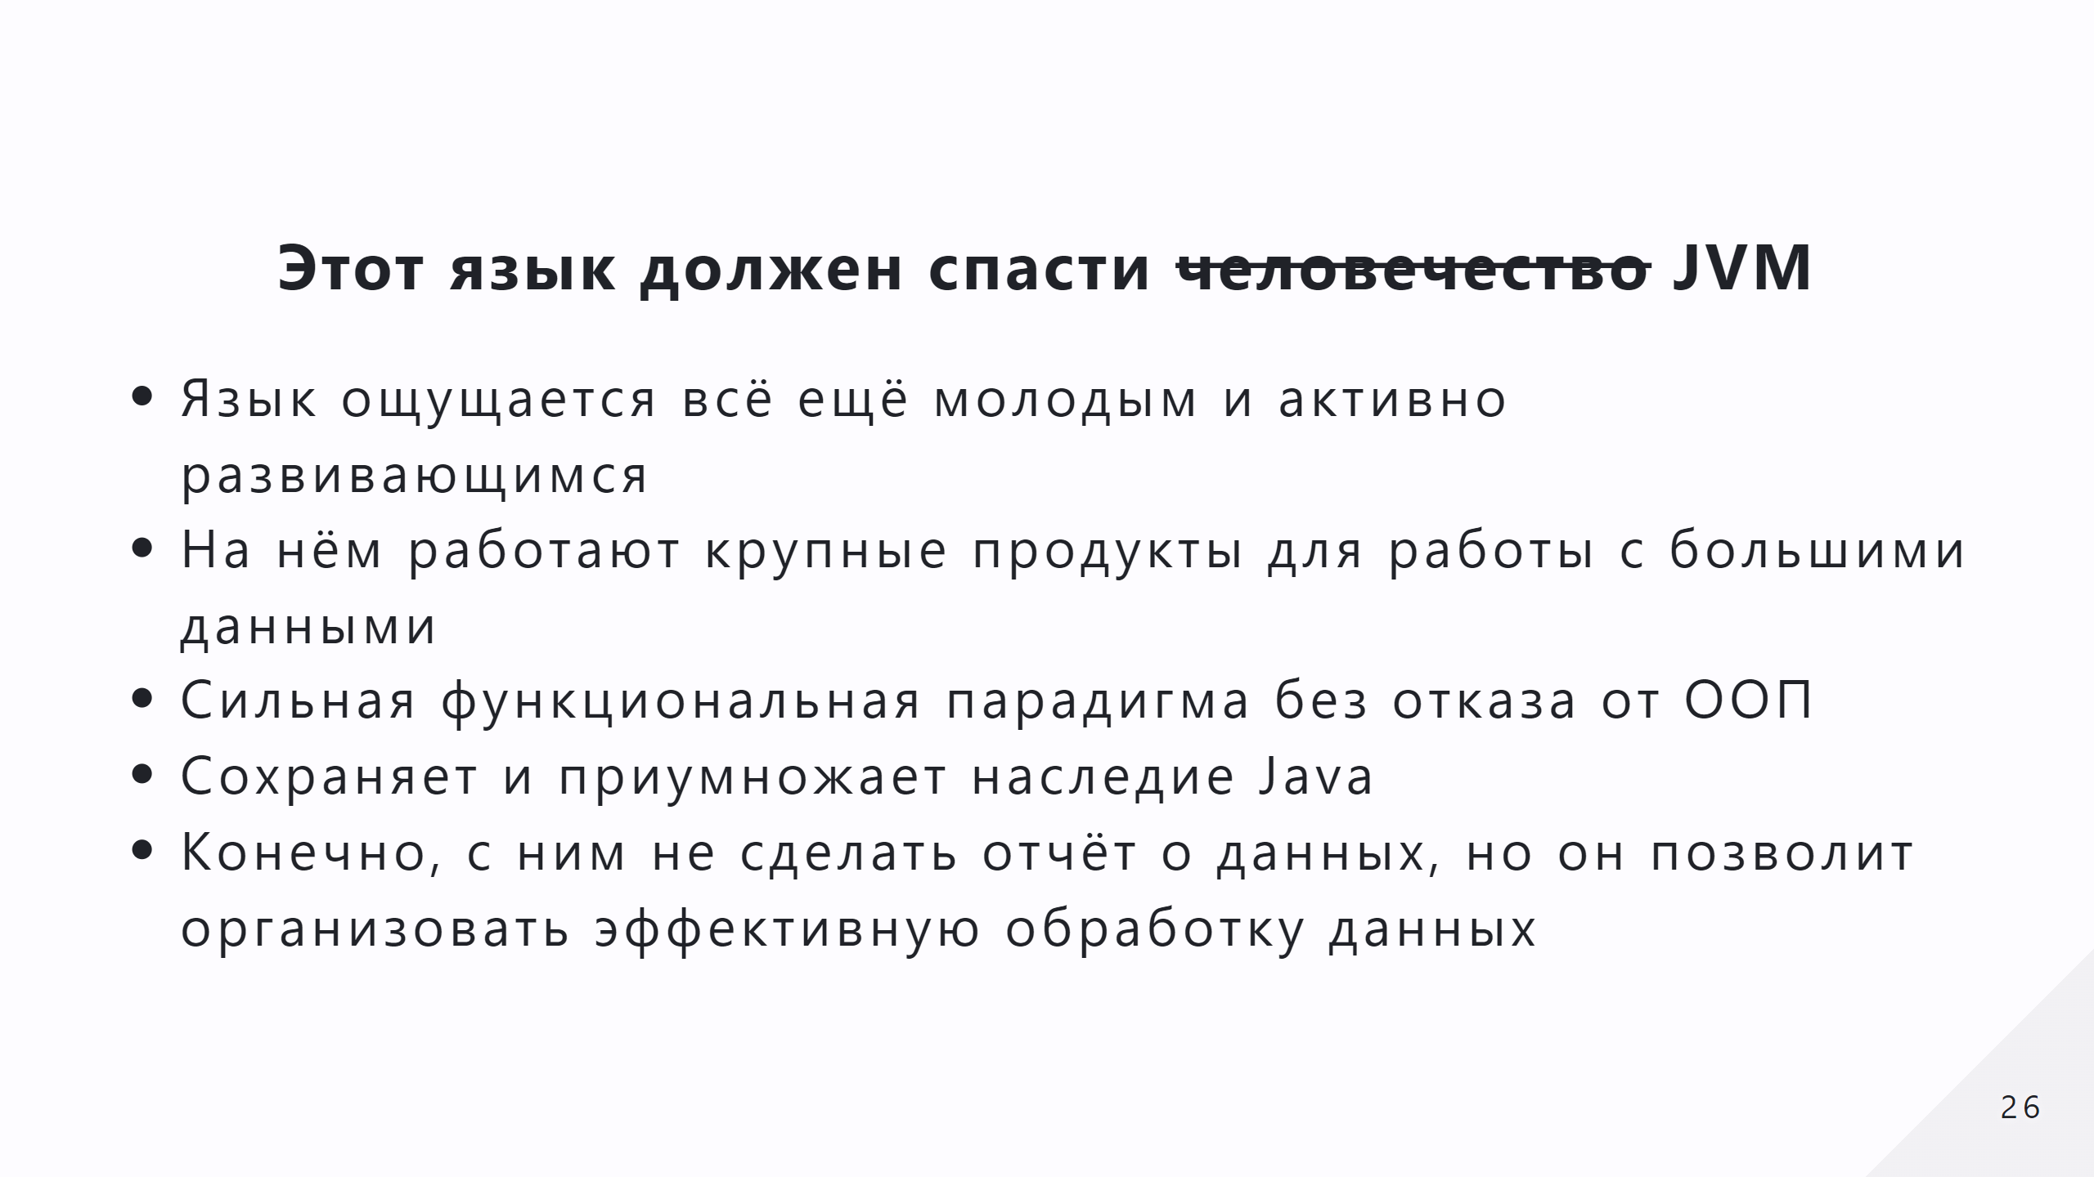

Slide 27
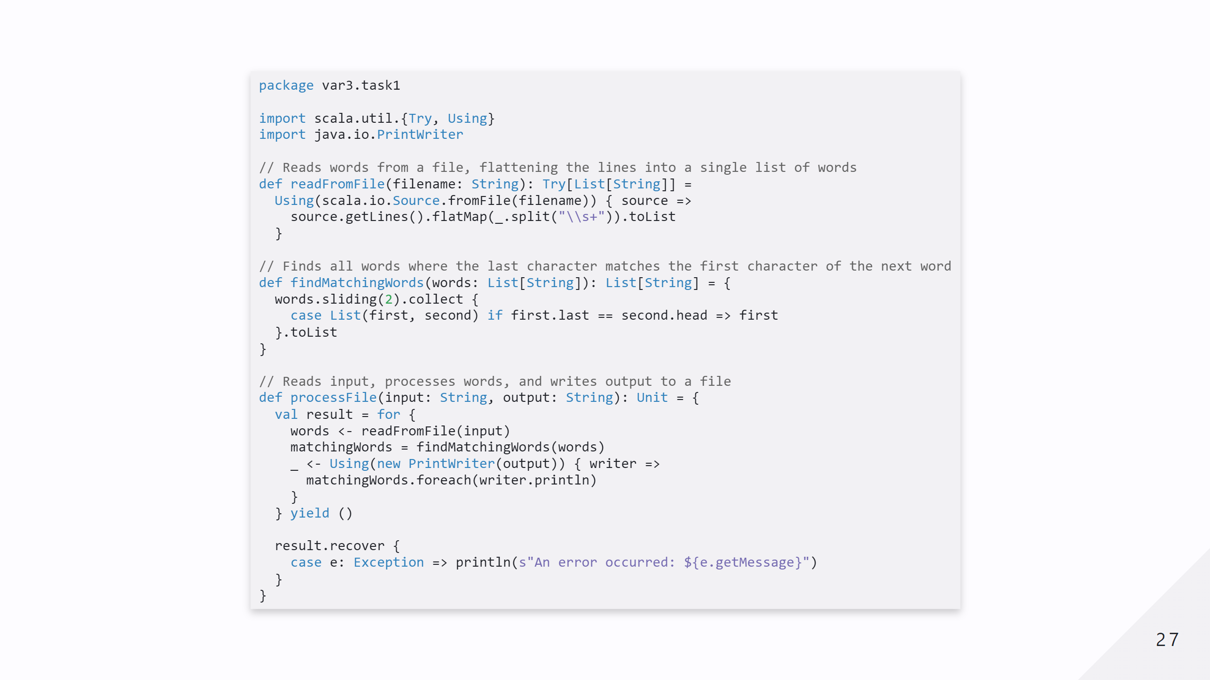
Notes:
- **`for` syntax with `<-`:** This allows you to _extract values_ from monadic types like `Try`, `Option`, or collections, and sequence operations in a readable, declarative way. Each `x <- something` extracts the value of `something` if it’s successful, otherwise, the operation stops (e.g., if it’s a `Failure` or `None`). - **`yield`:** After the `for` block finishes, `yield` specifies what the final result should be. In this case, it combines the extracted values and returns a new monad (here, another `Try`). - `readFromFile(input)` is a `Try[List[String]]`. It might succeed (returning a `Success(List[String])`) or fail (returning a `Failure(Exception)`). - The `<-` operator extracts the successful value (`List[String]`) if `readFromFile` succeeds. If it fails, the rest of the `for` block is skipped, and the result of `processFile` will be a `Failure`. - The `Using` block ensures that the `PrintWriter` resource is safely closed after use. - `matchingWords.foreach(writer.println)` writes each word from the list to the output file. - The result of this block is a `Try[Unit]` (successful if the file was written, or a failure if an exception occurred). - `<-` extracts the result of the `Using` block if it’s successful. If it fails, the rest of the `for` block stops. - The `result` of the `for` block is a `Try[Unit]`. - If any step in the `for` block failed, the `recover` block ensures that the error is handled gracefully by printing the exception message.

Slide 28
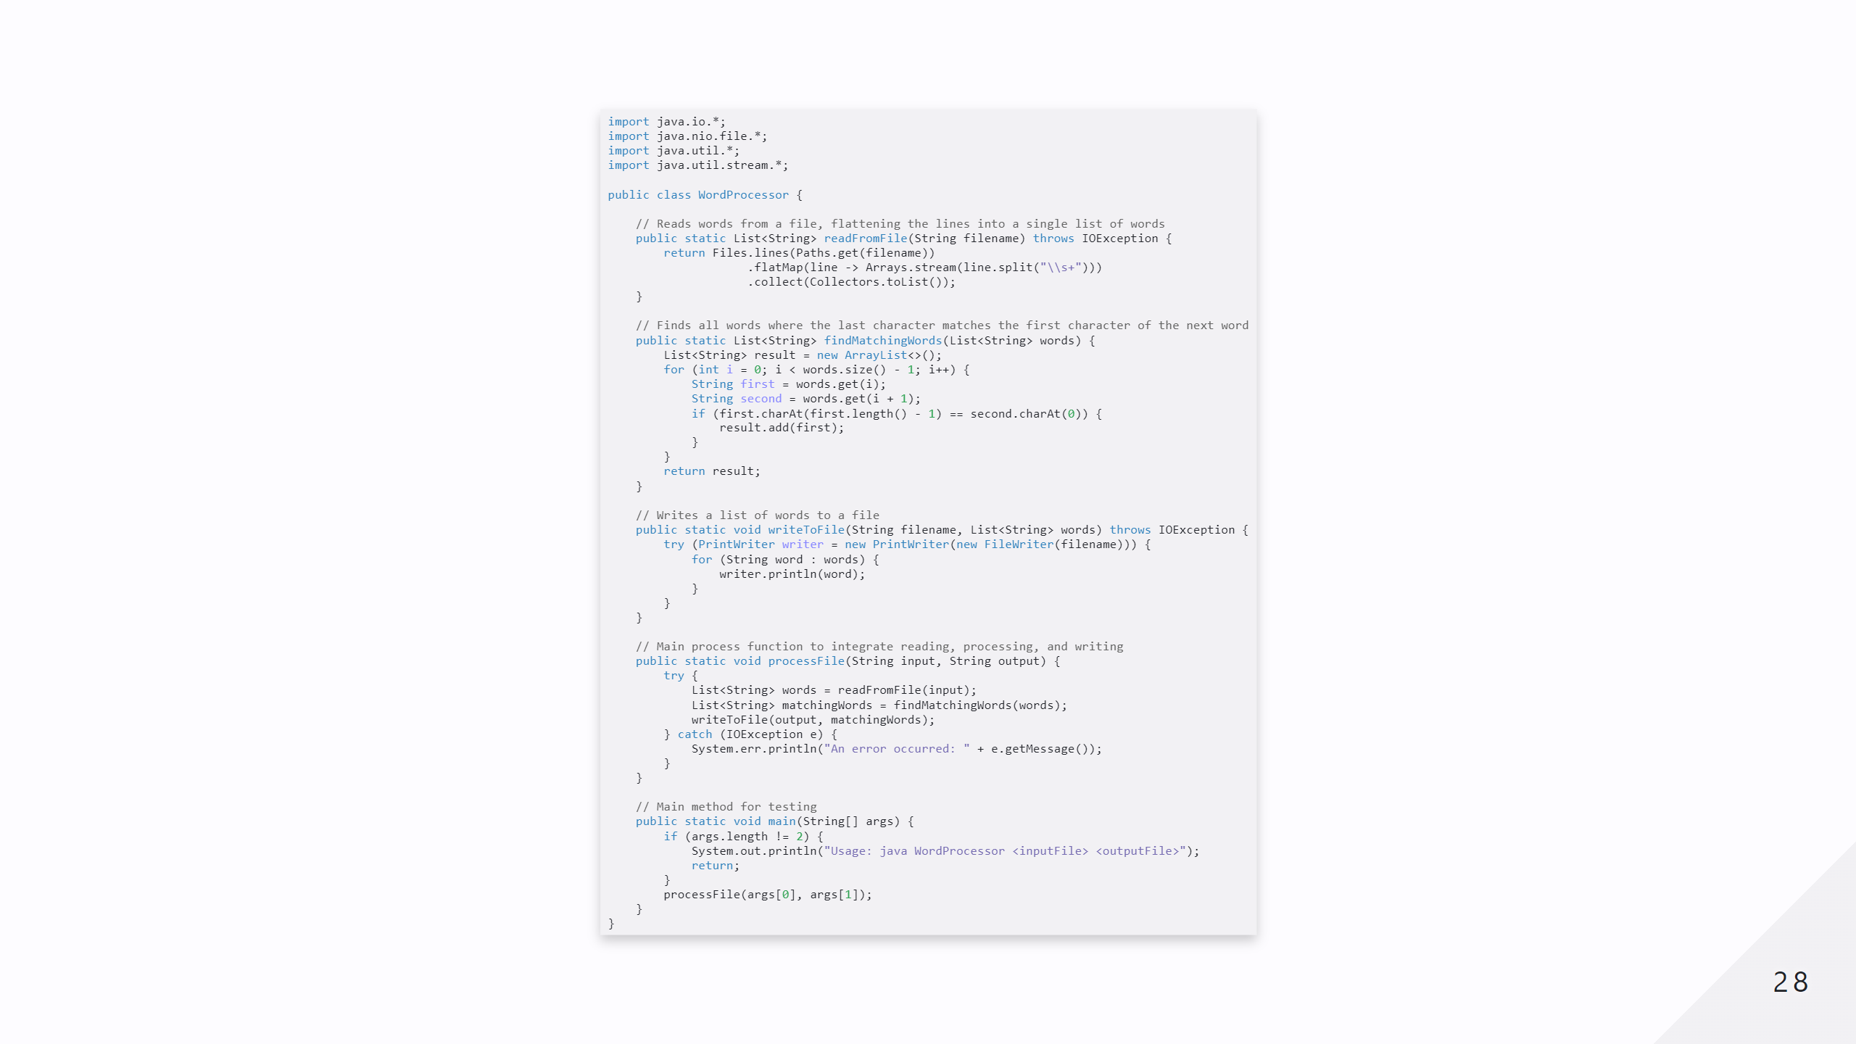

Slide 29
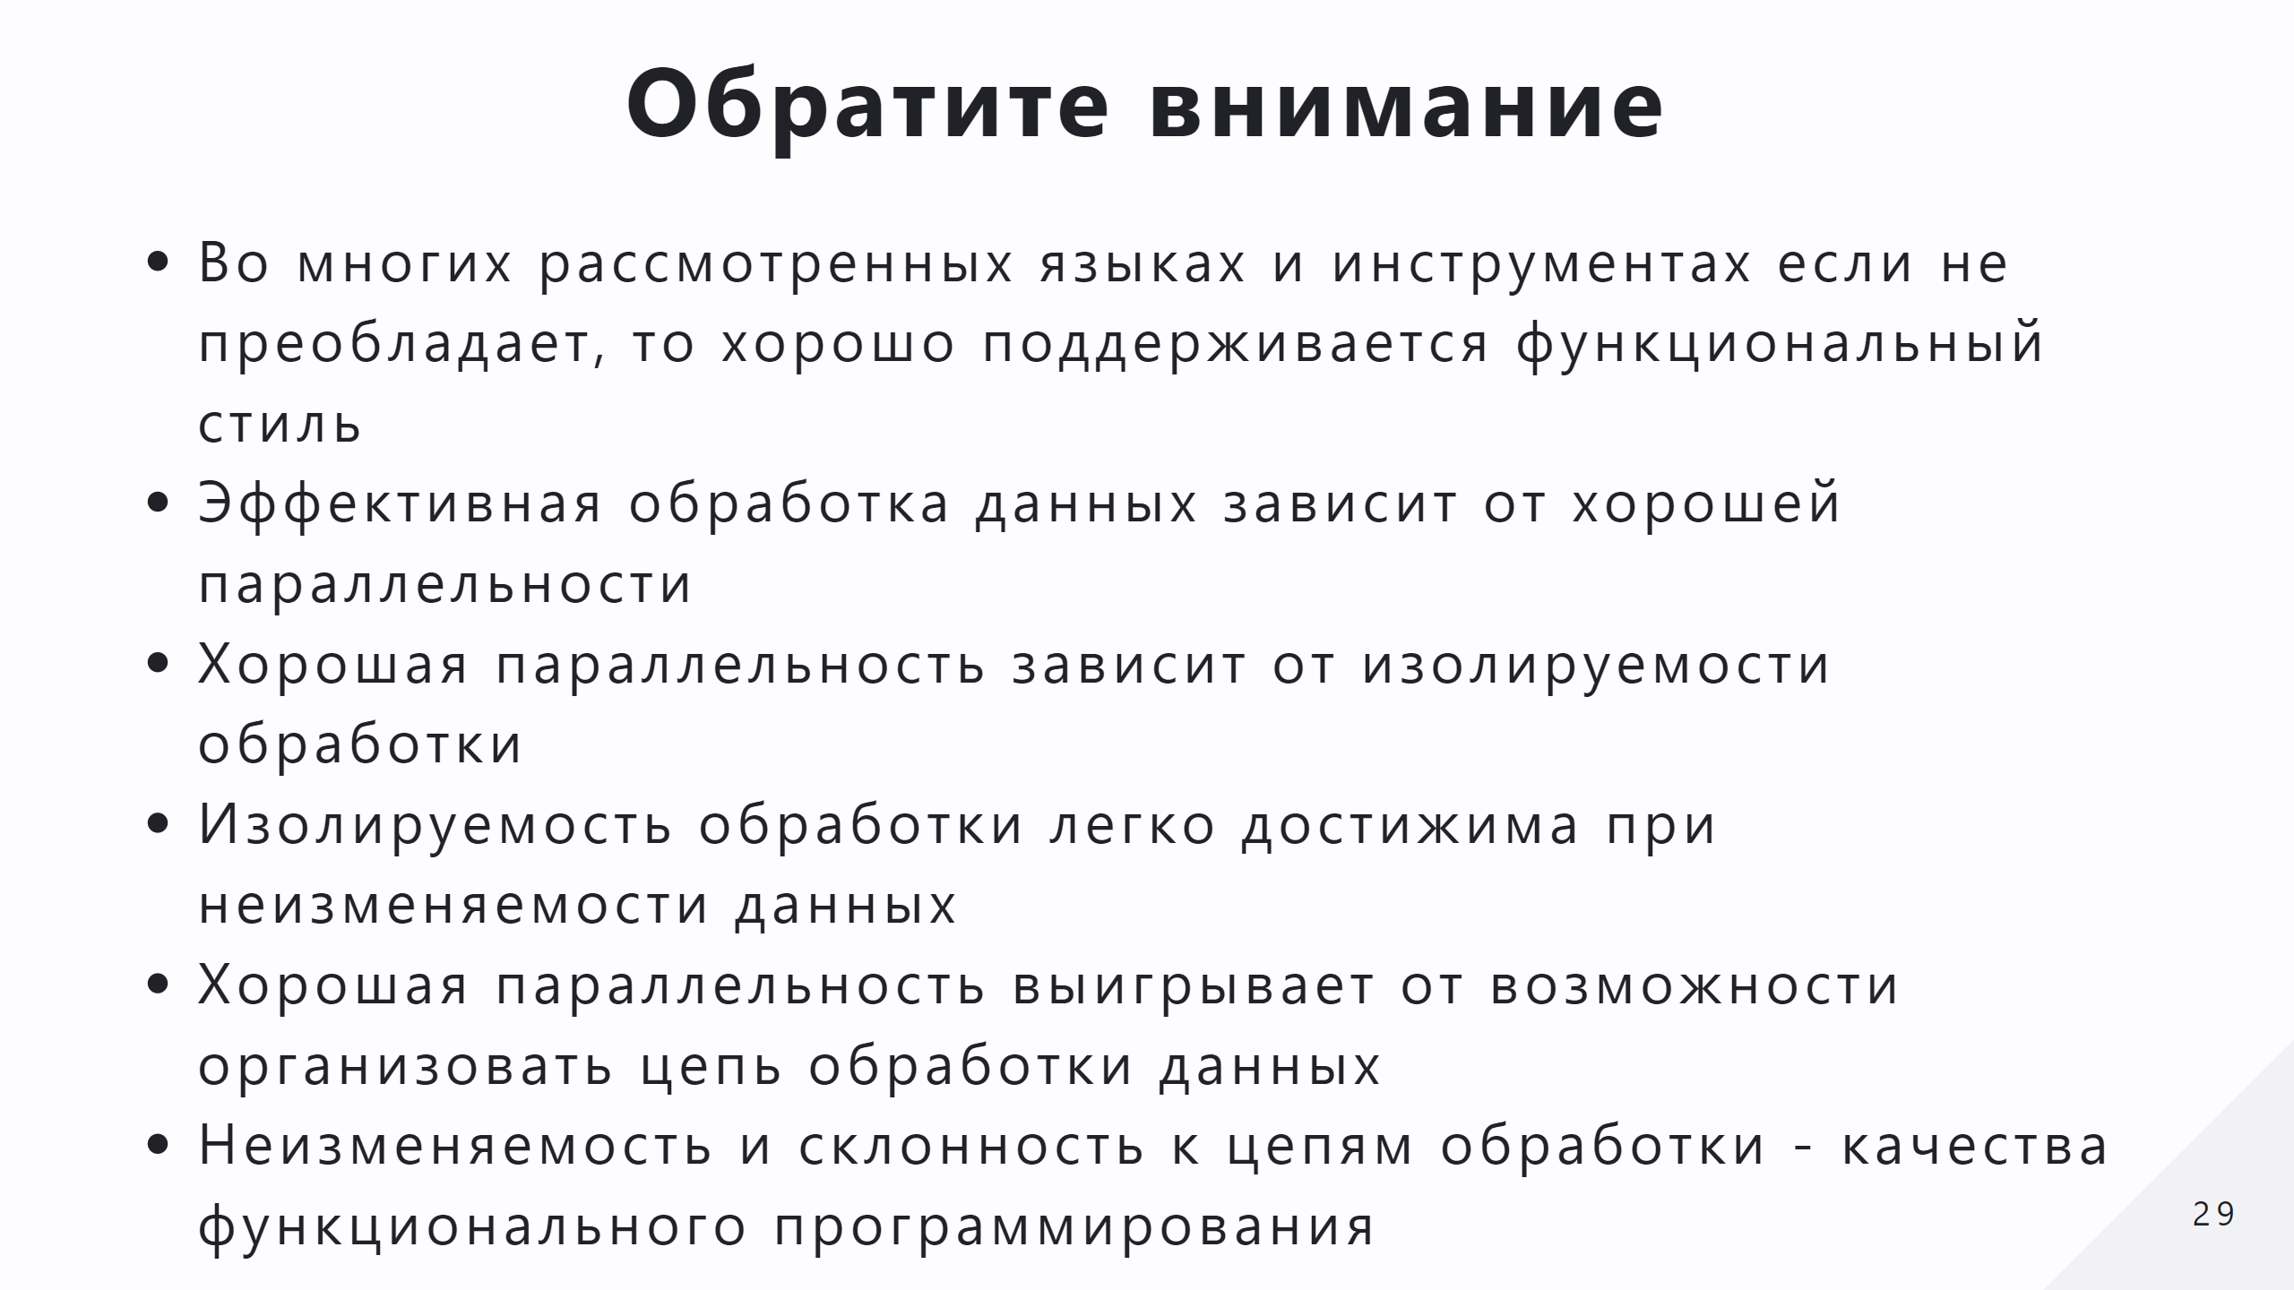

Slide 30
